Slide 1
Soft Matter Physics
Lecture
by CLAUDIA Mierke,Mareike Zink and Josef A. Käs
Summer 2013
University of Leipzig

Slide 2
Minitest
Why is soap slippery?

Slide 3
DLVO theory
named after Derjaguin and Landau, Verwey and Overbeek
describes the force between charged surfaces interacting through a liquid medium
combines the effects of the van der Waals attraction and the electrostatic repulsion due to the so called double layer
electrostatic part of DLVO is computed when the potential energy of an elementary charge on the surface is much smaller than the thermal energy scale, k_{B}T
between colloidal particles there were both a medium-range strong repulsion and a long-range strong attraction, explained by DLVO

Slide 4
For two spheres of radius a with constant surface charge Z separated by a center-to-center distance r in a fluid of dielectric constant ε containing a concentration n of monovalent ions, the electrostatic potential takes the form of a screened-Coulomb or Yukawa repulsion:

Slide 5
The Bjerrum length:
the separation at which the electrostatic interaction between two elementary charges is comparable in magnitude to the thermal energy scale, k_{B}T,
For water at room temperature it is 0.7 nm.

Slide 6
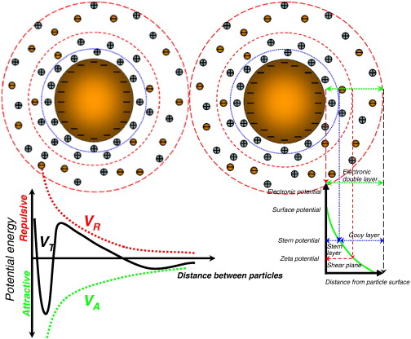

Slide 7
Combining the van der Waals interaction energy and the double layer interaction energy, the interaction between two particles or two surfaces in a liquid can be expressed as:
where W(D)_{R} is the repulsive interaction energy due to electric repulsion and W(D)_{A} is the attractive interaction energy due to van der Waals interaction.

Slide 8
Derivation of DLVO theory for plates
van der Waals attraction:
the total of dipole-dipole force, dipole-induced dipole force and dispersion forces, pair potential between two atoms or small molecules is purely attractive and of the form w= -C/r⁶, net interaction energy between a molecule and planar surface
where
w(r) is the interaction energy between the molecule and the surface
ρ1 is the number density of the surface.
z is the axis perpendicular with the surface and passes across the molecule. z = 0 at the point where the molecule is and z = D at the surface.
x is the axis perpendicular with z axis, where x = 0 at the intersection.

Slide 9
the interaction energy of a large sphere of radius R and a flat surface can be calculated as
where W(D) is the interaction energy between the sphere and the surface and ρ2 is the number density of the sphere

Slide 10
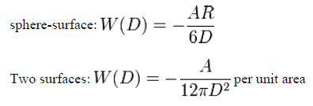

Slide 11
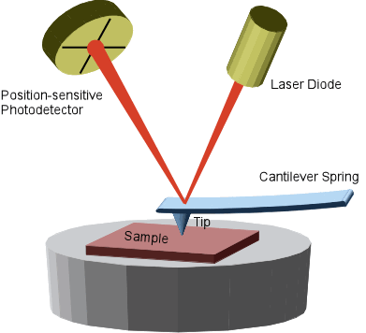
VdW Attraction in AFM

Slide 12
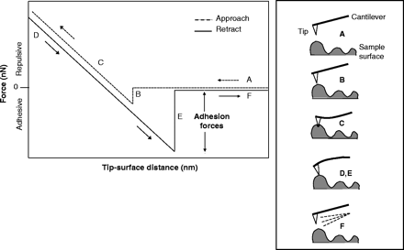

Slide 13
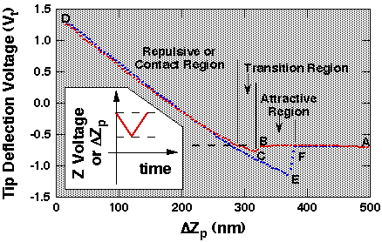

Slide 14
Double layer forces
occur between charged objects across liquids, typically water
acts over distances that are comparable to the Debye length
for two similarly charged objects, this force is repulsive and decays exponentially at larger distances
for unequally charged objects and eventually at shorted distances, these forces may also be attractive
osmotic pressure generates a force between these objects.

Slide 15
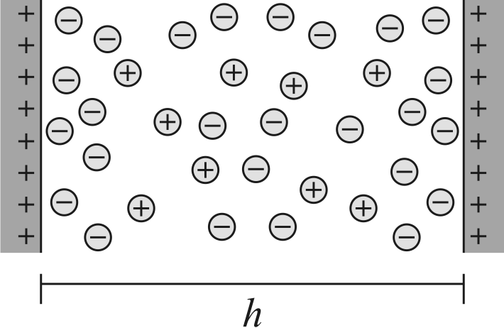
adsorbing soap molecules make the skin negatively charged, and the slippery feeling is caused by the strongly repulsive double layer forces

Slide 16
Debye-Hückel model
Superposition approximation
When the surfaces are sufficiently far apart, the potential profiles originating from each individual surface will not be much perturbed by the presence of the other surface.
The solution of the DH equation for an isolated:
where z is the distance from the surface and ψ_{D} the surface potential. The potential at the midplane is thus given by twice the value of this potential at a distance z = h/2.

Slide 17
Gibbs-Duhem relation for a two component system:
This result can be simply generalized to highly charged surfaces, but only at larger separations. Even if the potential is large close to the surface, it will be small at larger distances, and can be described by the DH equation. However, in this case one has to replace the actual diffuse layer potential ψ_{D} with the effective potential ψ_{eff}.

Slide 18
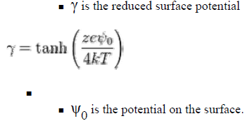
Double layer force:
the repulsive free energy per unit area between two planar surfaces

Slide 19
The interaction free energy between two spheres of radius R is

Slide 20
Counterion condensation
commonly described by Manning’s theory, which assumes that counterions can condense onto the surface ions until the charged density between neighboring monomer charges along the surface ion chain is reduced below a certain critical value
phenomenon of counterion condensation now takes place when the dimensionless Coulomb coupling strength
Γ = λ_{B} / l_{charge} > 1
where λ_{B} represents the Bjerrum length and l_{charge} the distance between neighboring surface charges.

Slide 21
Solvation, structural and hydration forces
Intermolecular and Surface Forces: With Applications to Colloidal and Biological Systems, Jacob N. Israelachvili Academic PrESS

Slide 22
Molecular ordering at surfaces, interfaces and in thin films
when two surfaces or particles approach closer than a few nanometers, continuum theories of attractive van der Waals and repulsive double-layer forces often fail
for the interaction of surfaces and particles, structural forces come into play
solute molecules often perturb the local ordering of solvent molecules
solvation forces depend not only on the properties of the intervening medium but also on the chemical and physical properties of the surfaces

Slide 23
when the medium is in water, the force is called hydration force
forces can be very strong at short range
solvation (or structuring) of solvent molecules at a surface is determined primarily by the geometry of molecules and how they can pack around a constraining boundary

Slide 24
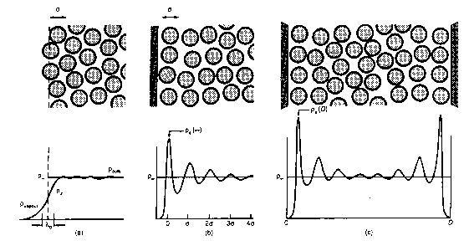
Solid–liquid interface:
attractive interactions between the wall and liquid molecules and the geometric constraining effect of the ’hard wall’ on these molecules force them to order into quasi-discrete layers.
reflected in an oscillatory density (force) profile extending several molecular diameters into the liquid:

Slide 25
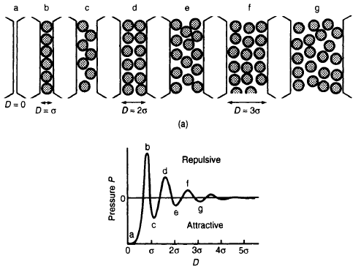
constraining effect for the liquid–solid interface is much more dramatic for two solid surfaces

Slide 26
Origin of main type of solvation force: The oscillatory force
The repulsive electrostatic double-layer pressure between two charged surfaces at distance D, P(D), separated by a solvent containing the surface counterions is given by the contact value theorem:
equations apply to solvation forces so long as there is no interaction between the walls and liquid molecules

Slide 27
While theoretical work relevant to practical systems is still in its infancy, there is a rapidly growing literature on experimental measurements.

Slide 28
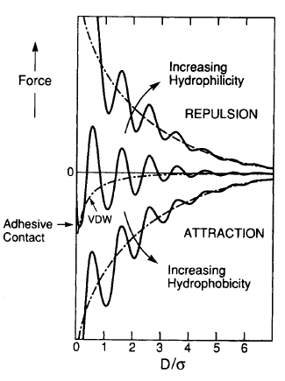
Measurements and properties of solvation forces: Oscillatory forces in nonaqueous liquids
Magnitude of forces :
The oscillatory force can exceed the van der Waals force at separations below five to 10 molecular diameters
for simple ( non-polymeric) liquids, merges with the continuum van der Waals or DLVO force at larger separations

Slide 29
Solvation forces in aqueous systems: Repulsive ’hydration’ forces
certain clays, surfactant soap films, uncharged lipid bilayers and biological membranes swell spontaneously or repel each other in aqueous solutions
Additional short-range forces are acting that are not oscillatory but smoothly varying, i.e. monotonic. Between hydrophilic surfaces this force is exponentially repulsive and is commonly referred to as the hydration or structural force.
Repulsive hydration forces appear to arise whenever water molecules strongly bind to surfaces containing hydrophilic groups.
There are two types of such forces: 1. Steric hydration forces, 2. Repulsive hydration forces

Slide 30
Solvation forces in aqueous systems: Attractive ’hydrophobic’ forces
hydrophobic surface is one that is inert to water in the sense that it cannot bind to water molecules via ionic or hydrogen bonds
the orientation of water molecules in contact with a hydrophobic molecule is entropically unfavorable and they attract each other to reduce the free energy
The hydrophobic force law between two macroscopic surfaces is long range, decaying exponentially with a decay length of 1-2 nm in a range 0-10 nm.
The hydrophobic force can be much stronger than the van der Waals attraction.

Slide 31
Fluctuation forces
Intermolecular and Surface Forces: With Applications to Colloidal and Biological Systems, Jacob N. Israelachvili Academic PrESS

Slide 32
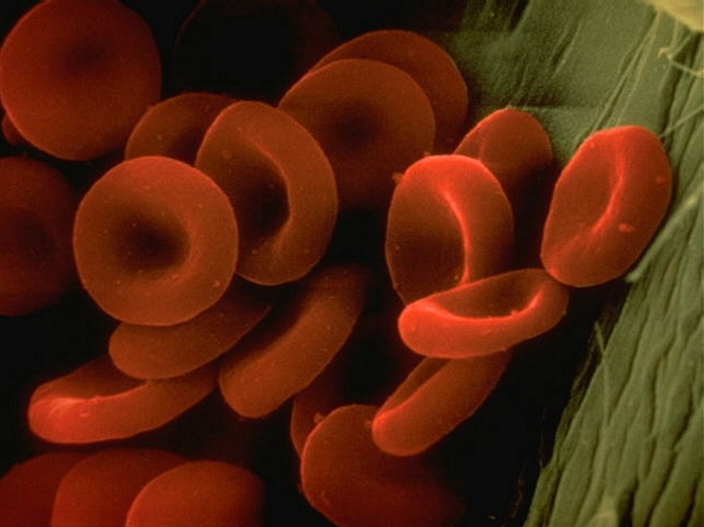
Red Blood Cell Fluctuations
Frequency spectrum of the flicker phenomenon in erythrocyte, F Brochard-Wyart, J-F Lennon in Journal de Physique (main title) (1975)

Slide 35
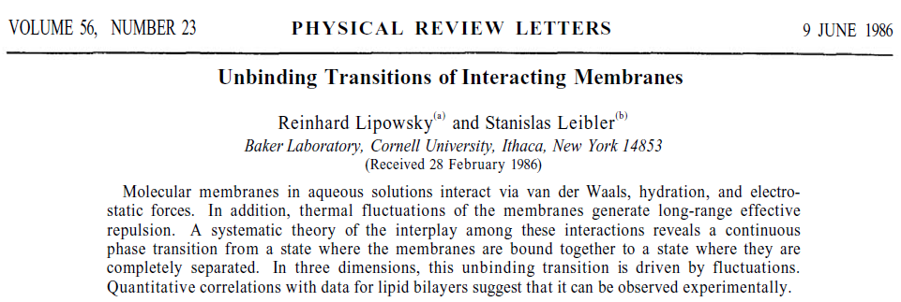
For two parallel membrane segments a distance l apart, the total interaction energy per unit area can be written

Slide 36
the hydration energy:
the electrostatic energy:
the van der Waals interaction energy:
unbinding may be explained in terms of an effective steric interaction:

Slide 37
Diffuse interfaces
surface is thermally mobile, i.e. it is dynamically rough, not statically
two common types :
fluid-like interface that is inherently mobile, i.e. fluctuating, fluctuations can be in the range of a few Ångstroms, sufficient to affect the roughness significantly and thus the surface forces.
second type occurs when polymer chains, attached at some point to a surface, dangle out into a solution where they are thermally mobile, on approach of another surface the entropy of confining these dangling chains results in a repulsive entropy force, steric or overlap repulsion.

