Slide 1
The improved Spectrum Processing, Analysis and Presentation Software for XPS, AES, XAS and RAMAN Spectroscopy or How to actually use Unifit
UNIFIT 2024
M.Sc. Leon Rasmussen, Dr. Ronald Hesse

Slide 2
ProgramME features → Content
Window Types
Operation Calls (Commands)
Presetting
Import
Input/Output UNIFIT files
Modification
Fitting
Evaluation
Presentation/Design
Information
Export
XAS/AES/RAMAN
Analysis
What is new in UNIFIT 2024?
New in UNIFIT 2024

Slide 3
1. Window Types
Window Types
Fifteen window types are available:
Standard (original data, modification, peak fit)
Wagner Plot (Auger parameter)
3D Waterfall 0°
3D Waterfall 0°Plus
3D Waterfall 45°
3D Waterfall -45°
3D Colour Profile (peak-fit results, parameter dependent measurements (e.g. ARXPS))
XY 3D Plot 45°
XY 3D Plot -45°
XY 3D Colour Profile
XY 3D 45° Colour Profile
XY 3D -45°Colour Profile (multipoint measurement)
Parameter Plot (results of batch processing)
Image (e.g. corresponding SEM)
Show Windows Video Sequence (dynamic presentation of batch processing)

Slide 4
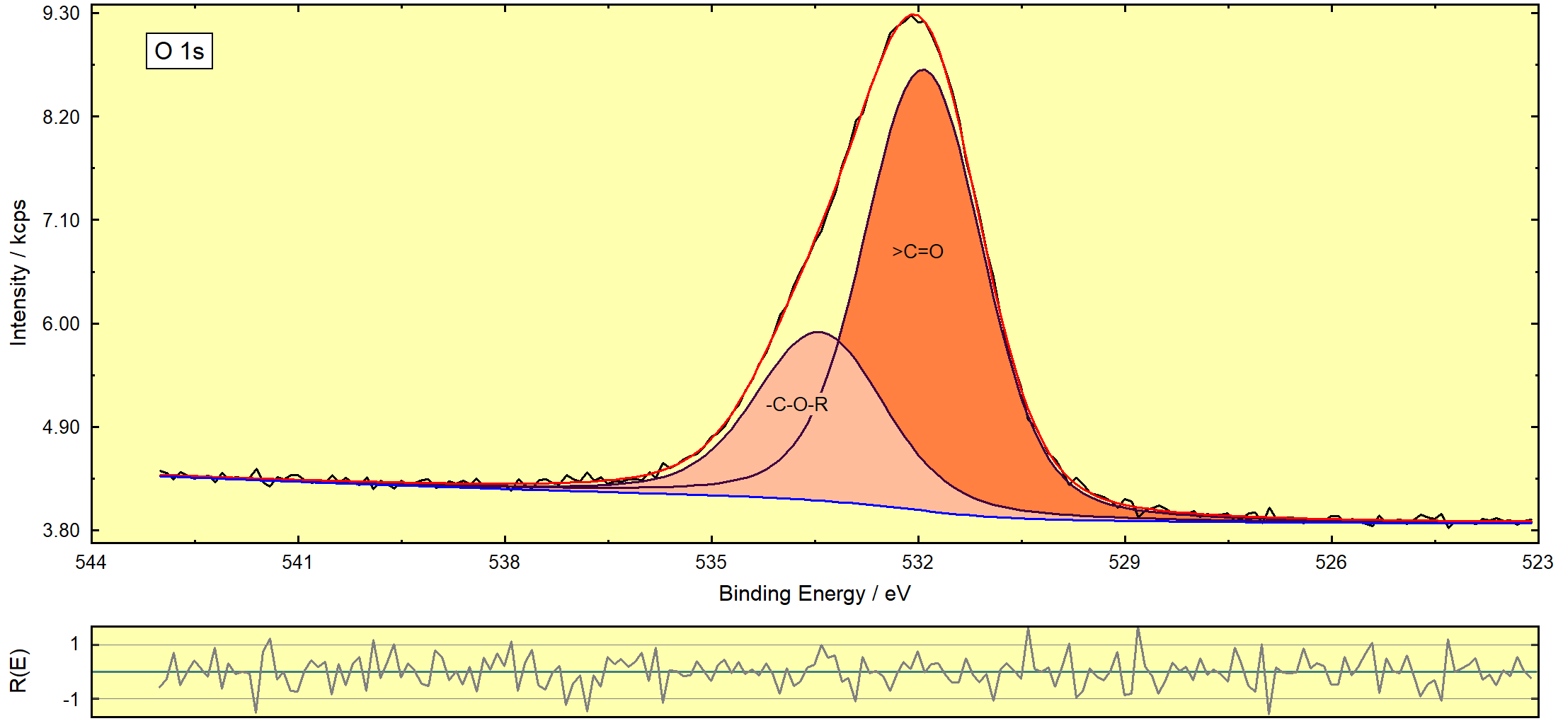
1. Window Types
1. Standard

Slide 5
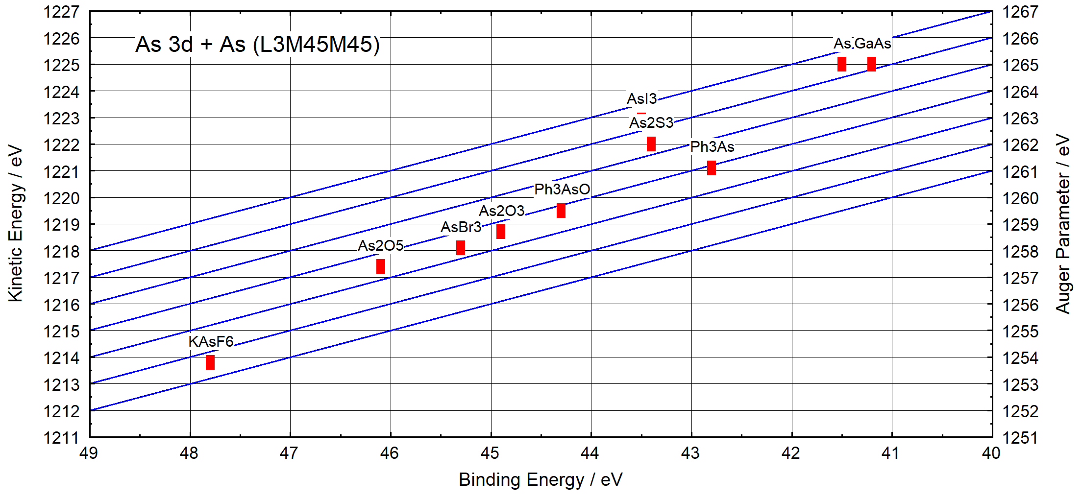
1. Window Types
2. Wagner Plot (Auger Parameter)

Slide 6
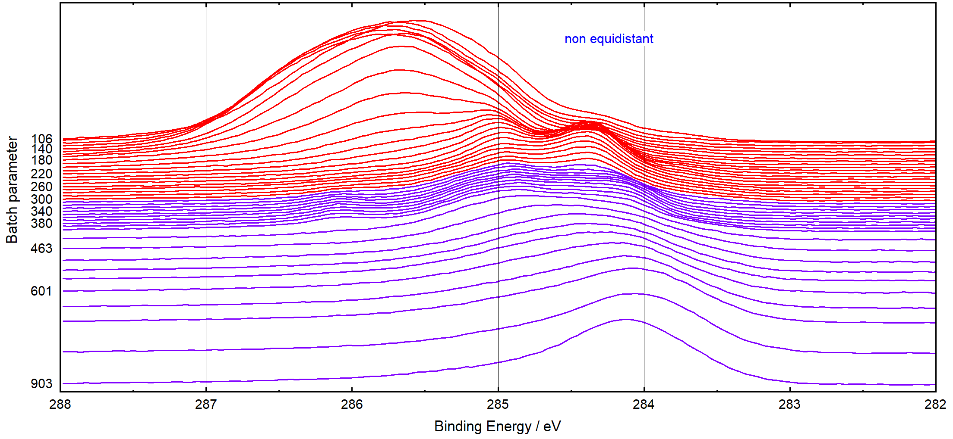
1. Window Types
3. 3D Waterfall 0°

Slide 7
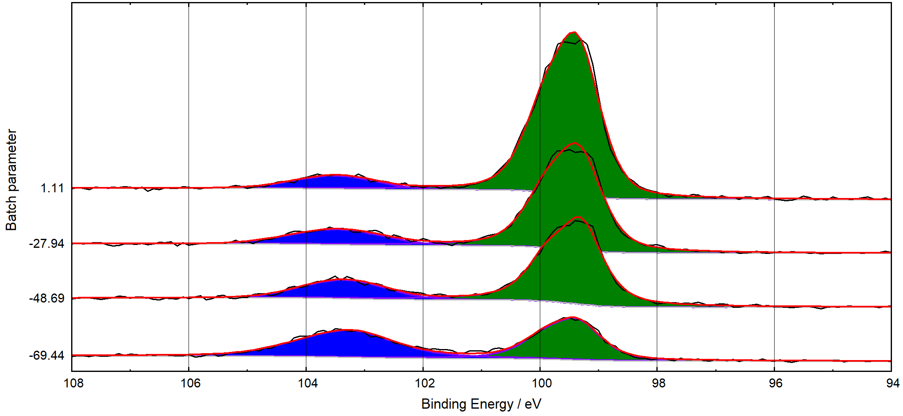
1. Window Types
4. 3D Waterfall 0°Plus (fitted spectra)

Slide 8
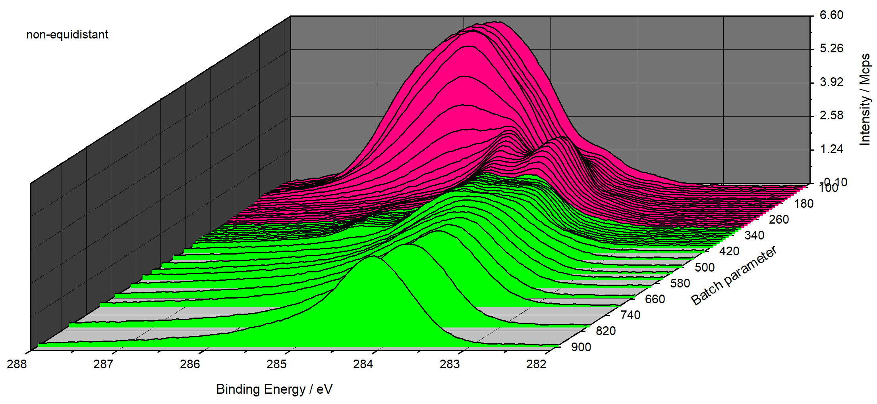
1. Window Types
5. 3D Waterfall 45°

Slide 9
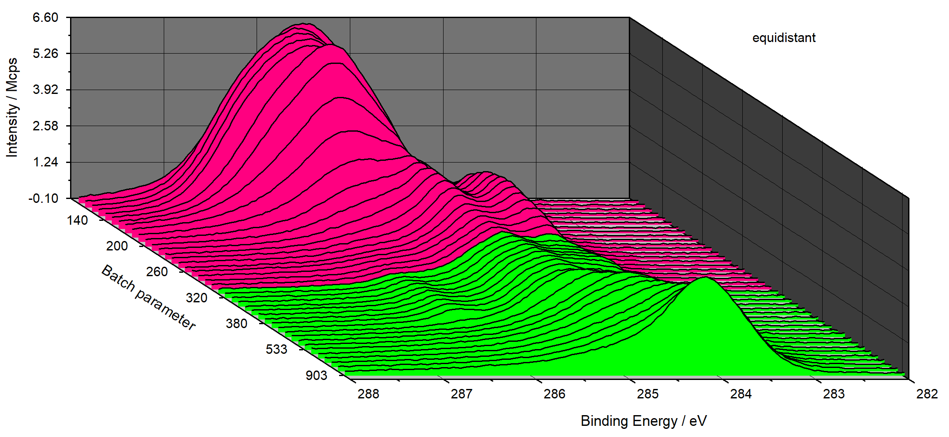
1. Window Types
6. 3D Waterfall -45°

Slide 10
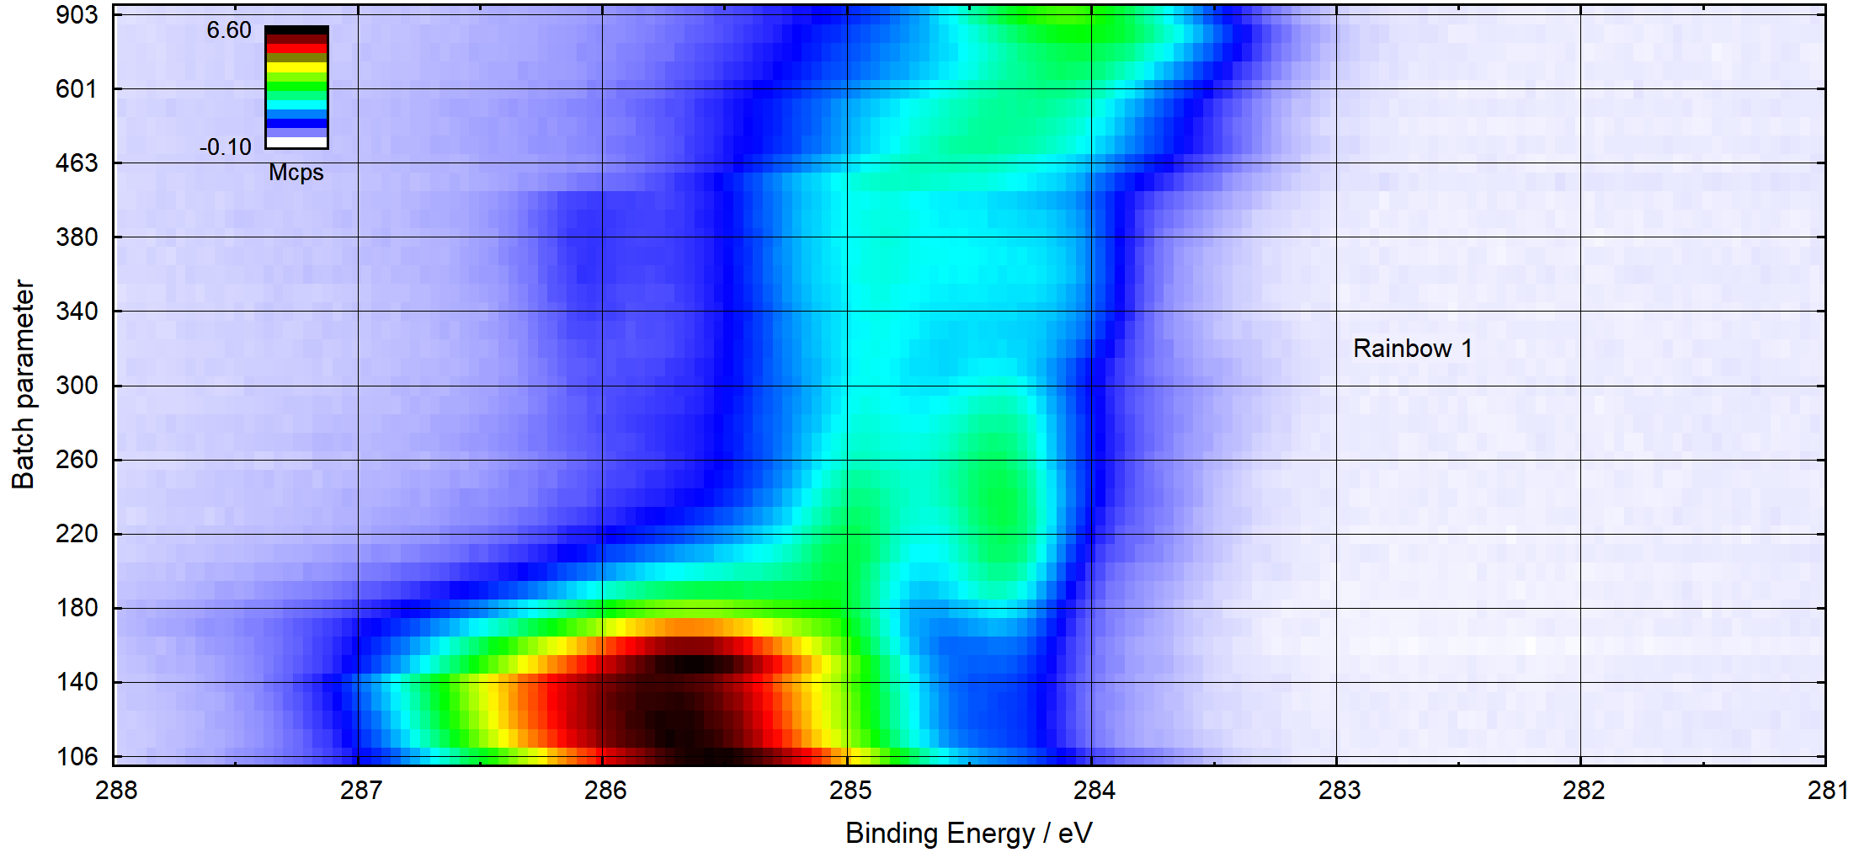
1. Window Types
7. 3D Colour Profile

Slide 11
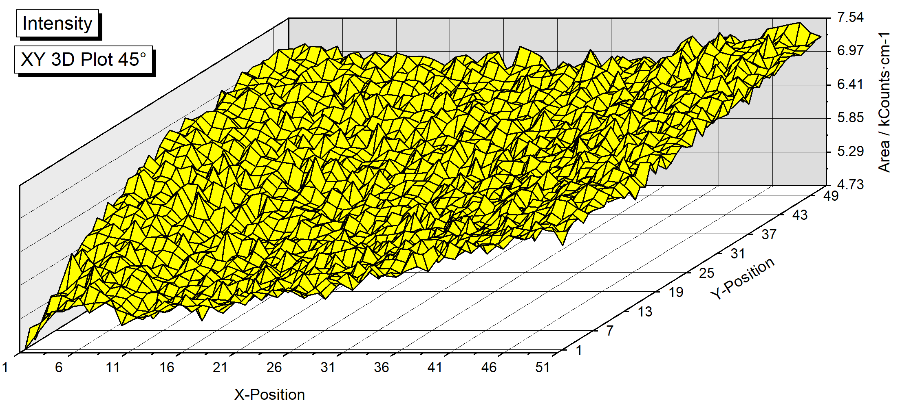
1. Window Types
8. XY 3D Plot 45°

Slide 12
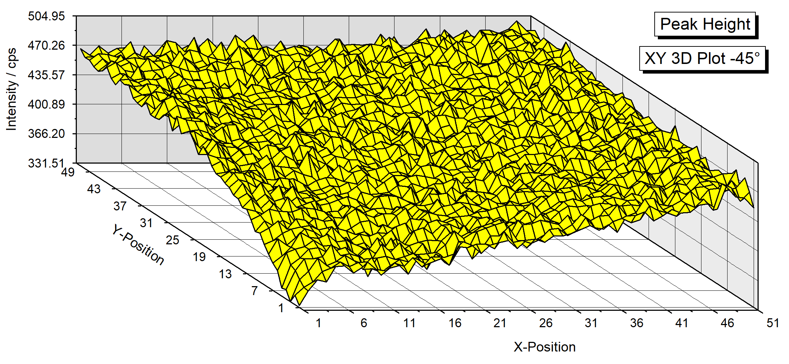
1. Window Types
9. XY 3D Plot -45°

Slide 13
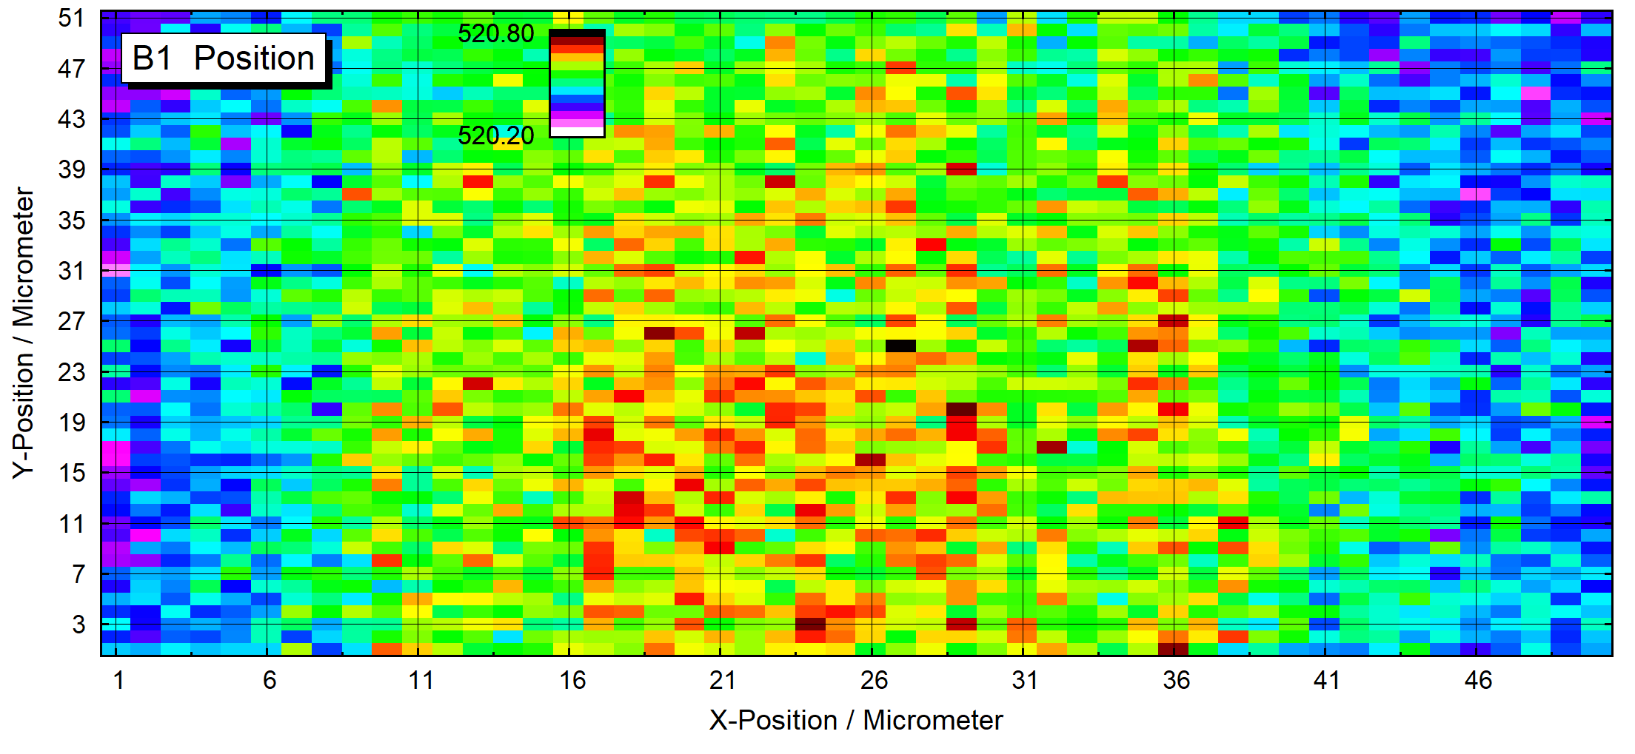
1. Window Types
10. XY 3D Colour Profile

Slide 14
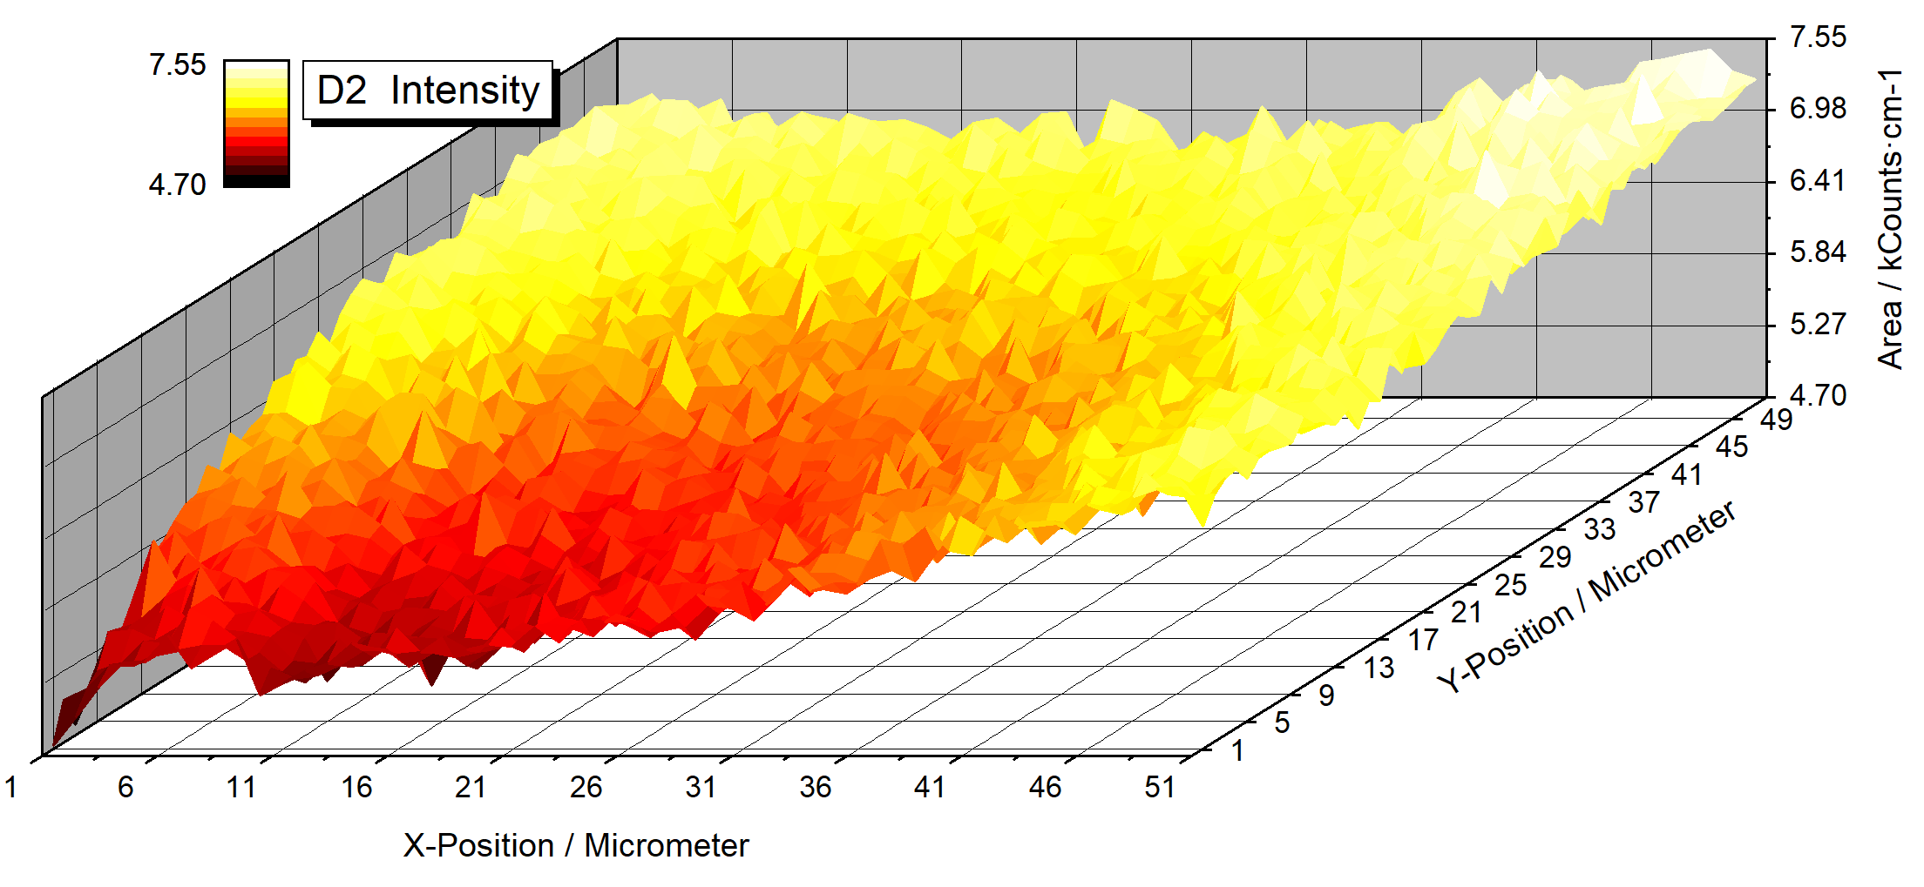
1. Window Types
11. XY 3D 45°Colour Profile

Slide 15
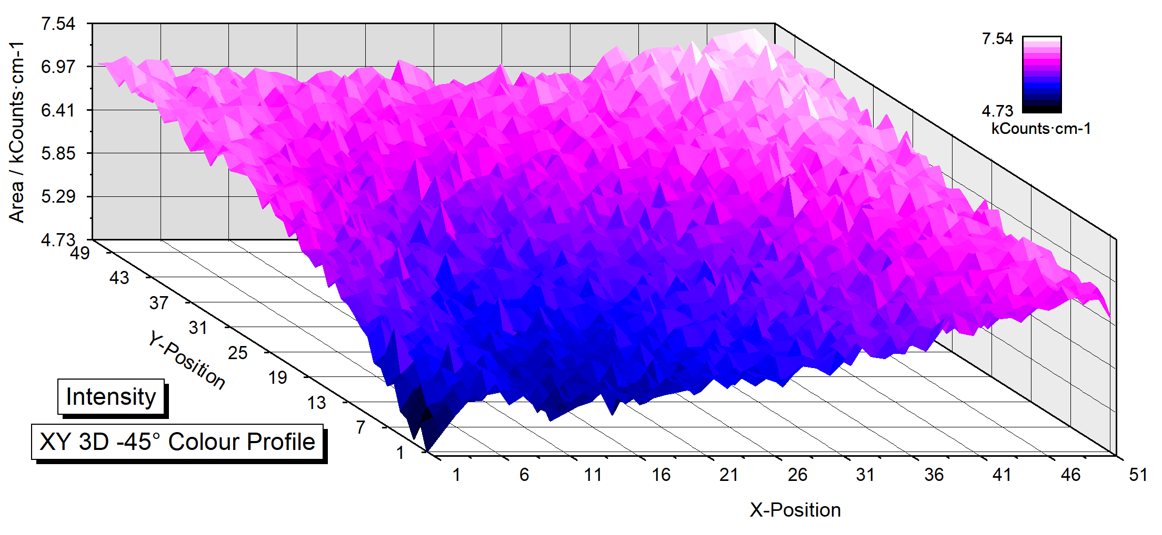
1. Window Types
12. XY 3D -45°Colour Profile

Slide 16
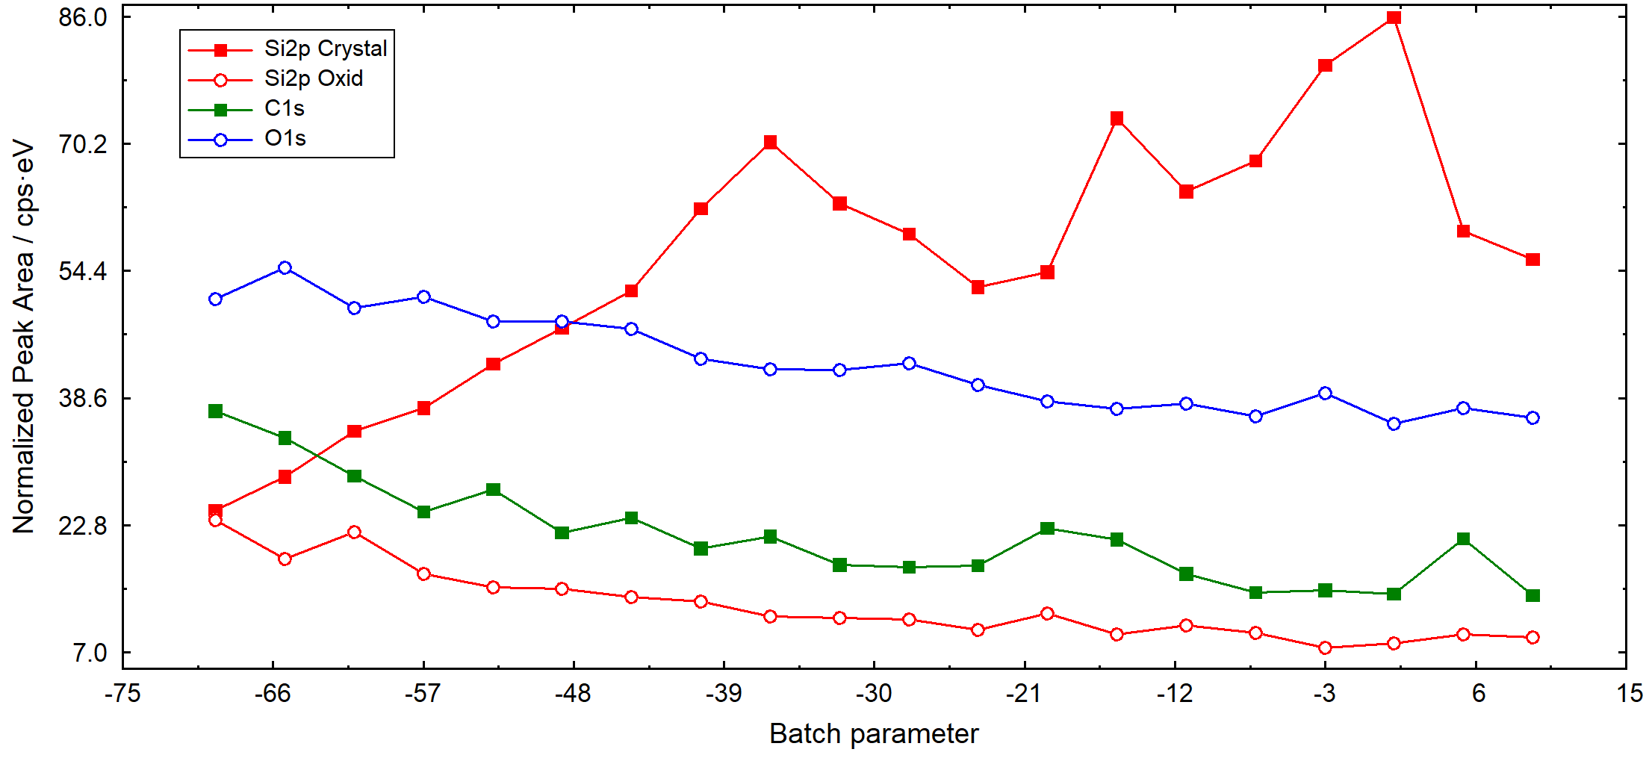
1. Window Types
13. Parameter Plot

Slide 17
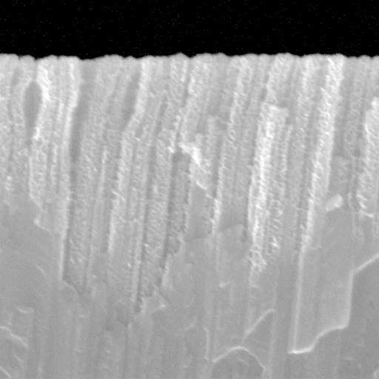
1. Window Types
14. Image

Slide 18
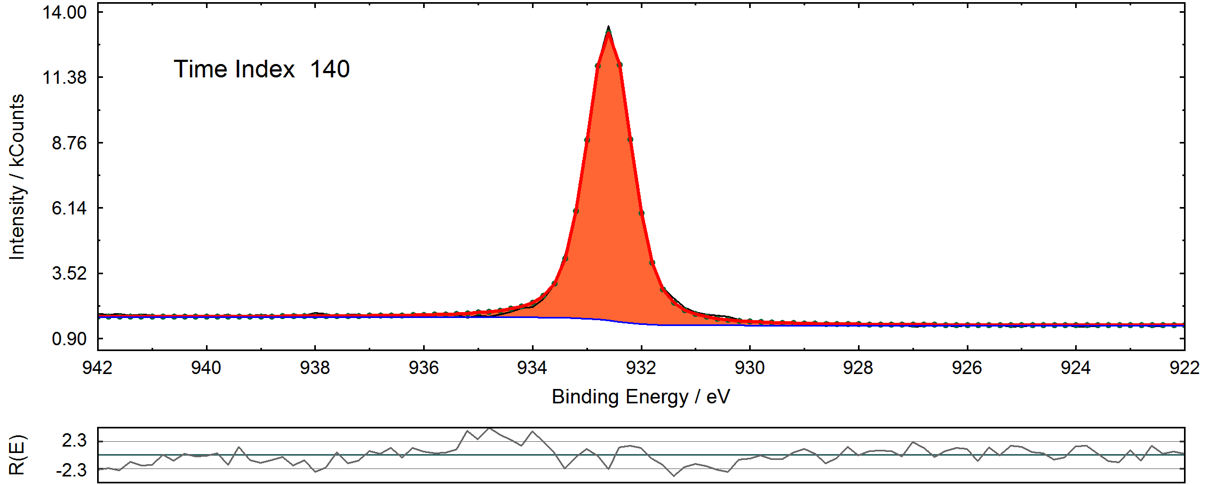
1. Window Types
15. Show Windows Video Sequence

Slide 19
2. Operation Calls
Operation Calls - available for the activated UNIFIT window (optionally for selected or all windows)
- If a dialogue is open and the active window is changed, then the dialogue is closed automatically!
Activation of Windows:
Left-Mouse Click
Page Up, Page Down – Keys
Pull-Down W. 1-3000, W: 3001-6000… (hidden window is displayed)
Dialogues:
Two ways to send a call are available:
Command Button
Shortcut of the Command Button with ‘Alt-Character‘
Do not change the active window if a dialogue is open!

Slide 20
2. Operation Calls
Operation Calls
Main menu:
Six ways to send a call are available (not for all programme calls):
i. Pull-Down Commands
ii. Shortcut with ‘Alt-Character‘ iii. Pop-Up Commands (different for the different UNIFIT-window types)
iv. Icons (Tool bar can be modified by the user.) v. Right-Mouse Button at the appreciate position vi. Left-Mouse Button (e.g. marker lines, shift of annotations, identify lines)
vii. Common Windows shortcuts with ‘Ctrl-Character’ e.g. Crtl-a: Programme-Internal Copying Ctrl-c: Programme-Internal Insertion Ctrl-z: Undo Ctrl-b: Ft Background

Slide 21
3. Presetting
New from UNIFIT 2024

Slide 22
New from UNIFIT 2024
3. Presetting – Setting of programME Parameters
maximum of 75600 processable windows (256x256 = 65536)
optimization of the main memory in use by setting programme parameters
optimization of the user interface (desktop) by hiding standard windows

Slide 23
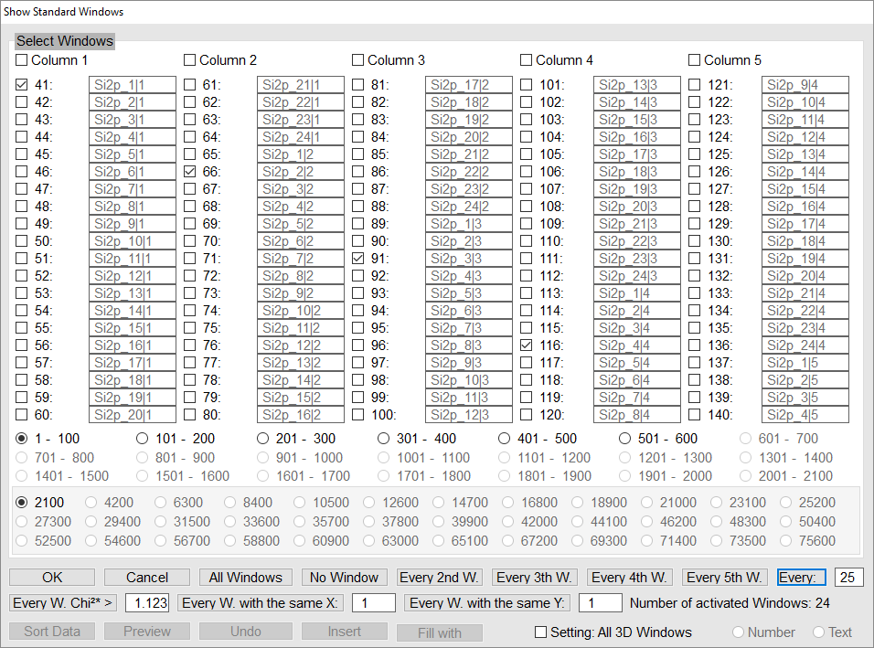
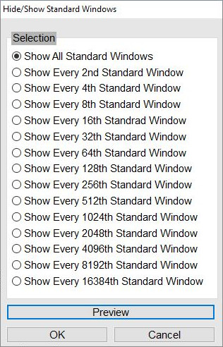
3. Presettings – Hide standard windows
automatic
manual
manually hidden windows will not be shown after reloading the project
path: Windows → Hide/Show Standard Windows / (manual)

Slide 24
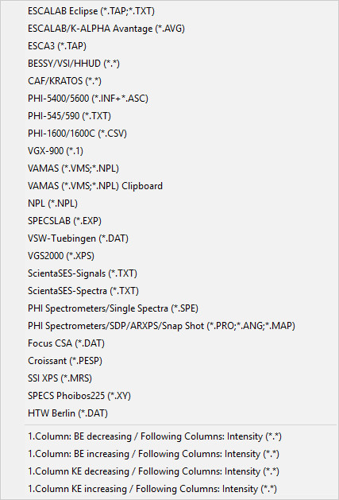
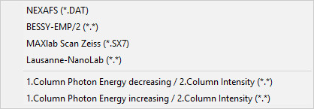
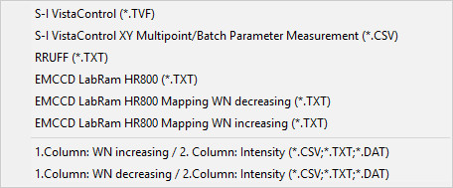
4. Import
XPS
XAS
data file information depending on file format
each file format needs its own input routine
UNIFIT 2024 offers a huge variety of input routines for common and special file formats
In UNIFIT 2024 importing of images is possible. If an image window is activated, processing tools are deactivated.
AES
RAMAN
path: File → Open Spectra → XPS/XAS/AES/RAMAN
File → Open Image…

Slide 25
4. Import – select spectra
Please note
‚Select spectra‘ and ‚Hide/Show Spectra‘ is not the same feature:
Selected spectra are loaded, but might be hidden. All spectra between the first and last activated spectrum can be selected using the ‚Shift-Key‘
New from UNIFIT 2022
path: File → Select Spectra (in order to select additional spectra later on)

Slide 26
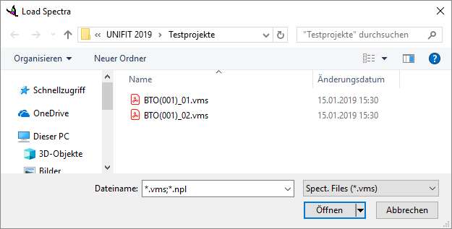
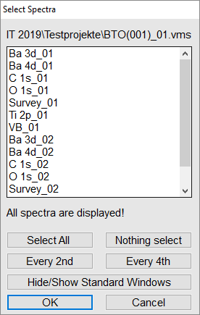
4. Import – Batch Loading of measurement daTa
file names: combination of a basic name and a batch parameter (number with maximum five digits)
!
BTO(001)_01.vms
supported data formats:
XPS: PHI spe-format (*.spe), VAMAS vms-format (*.vms), Scienta txt-format (Sum of Slices) (*.txt)
RAMAN: Wave Number increasing/decreasing (*.csv, *.txt, *.dat)
names of loaded regions → combination of region names and the batch names of the files
BTO(001)_02.vms
path: File → Open Spectra

Slide 27
5. INPUT/OUTPUT – UNIFIT Projects (*.ufp)
!
The UNIFIT projects are the most important storage option of
the software UNIFIT.
data format: *.ufp
saving and loading of all saved spectra windows with all: 1. processing steps 2. all design features 3. additional comments 4. quantification 5. thickness estimation
original measuring data are saved in a folder with the same name, e.g. project: Test.ufp, folder: Test
corresponding folder is necessary for the loading and saving of the projects (Do not remove the folder without removing the project! Transmit (e.g. via e-mail) the project always together with the folder.
UNIFIT projects of former versions can be loaded using newer versions!
path: File → Open Projects/Save Projects

Slide 28
5. INPUT/OUTPUT – UNIFIT Processing STEPS/ DESIGN FEATURES STANDAD WINDOwS (*.PPD)
saving and loading of processing steps and design features of a selected set of regions (standard windows only), no saving of: 1. formatted spectrum titles and annotation 2. interpolations 3. charge corrections
Loaded Regions Saved Processing Steps
1. Survey_01 Survey: 2. C1s_01 - Annotation 3. O 1s_01 O1s:
4. S2p_01 - Reduction 5. Survey_02 - Satellite Subtraction 6. C1s_02 - Fittable Background 7. O1s_02 - Peak Fit, Sum, Relative 8. S2p_02 C1s: - Reduction - Satellite Subtraction - Fittable Background - Peak Fit, Sum, Relative S2p; - Background Subtraction
path: File → Open/Save Project Processing Steps/Design Standard Windows

Slide 29
5. INPUT/OUTPUT – Annotation/Design (*.dsg)
saving of annotation, title, design features, windows size of the active window (path: Annotation/Design – Load/Save Annotation Design Display…)
loading of the design file and using for the active window, for all or selected window
5. INPUT/OUTPUT – PREFERNCES (*.SET)
saving of setting of the UNIFIT software (path: Preferences – Load/Save Preferences...)
file: Documents – Unifit_2022_User_Files – presetting – Presetting.set
different presetting files are offered (e.g. Presetting_Image_Export.set)
reloading and using for windows
5. INPUT/OUTPUT – FIT PARAMETERS (*.PAR)
saving and loading of the fit parameters, fit-parameter limits and fit background (path: Peak Fit – Load Start Parameters...

Slide 30
5. input/output – data banks
by UNIFIT 2023
*.pos (element lines/chemical shifts, XPS and AES)
*.dda (doublet parameters)
*.sen (sensitivity factors)
*.aup (auger parameters)
*.sat (satellite parameters)
*.trm (transmission function/IERF)
*.cro (inelastic scattering electron cross section/IESCS)
*.pai (two quantified regions, loadable for T(E) estimation)
modifiable and expandable by user

Slide 31
6. modification
Edit Parameters Standard Windows
Reduction/Expansion
Differentiation/Integration
Smoothing/Spike Correction/Mirror on x-axis
Normalization
Spectrum Manipulation (Energy Shift/Correct Intensity)
Spectrum Operation (Addition/Subtraction/Multiplication/Division)
Calculate/Subtract Background
Subtract Satellite
Charge Correction
Correction with IERF
Undo (up to hundred modification and design steps step)
Programme-Internal Copying/Insertion (transfer of spectra using two activated UNIFIT programms)
New from UNIFIT 2023

Slide 32
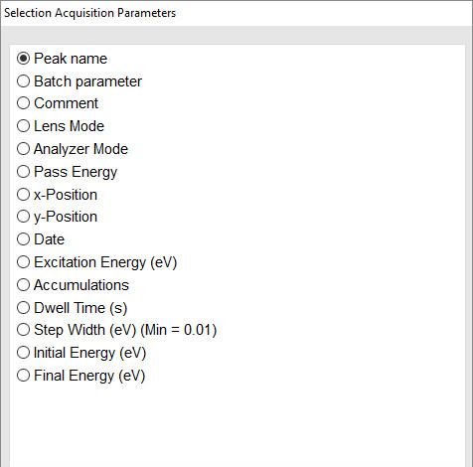
6. modification – Edit (Acquisition) Parameters of Standard Windows
path: Annotation/Design → Edit Parameters Standard Windows

Slide 33
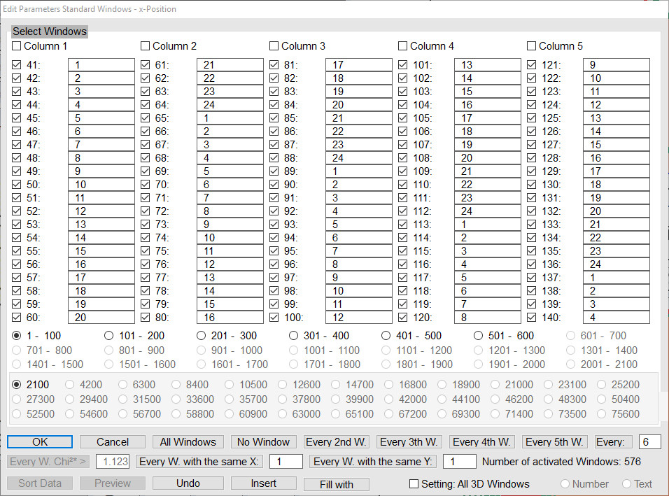
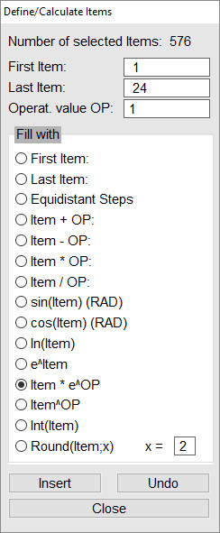
6. Modification – Edit (Acquisition) Parameters of Standard Windows
x position
path: Annotation/Design → Edit Parameters Standard Windows

Slide 34
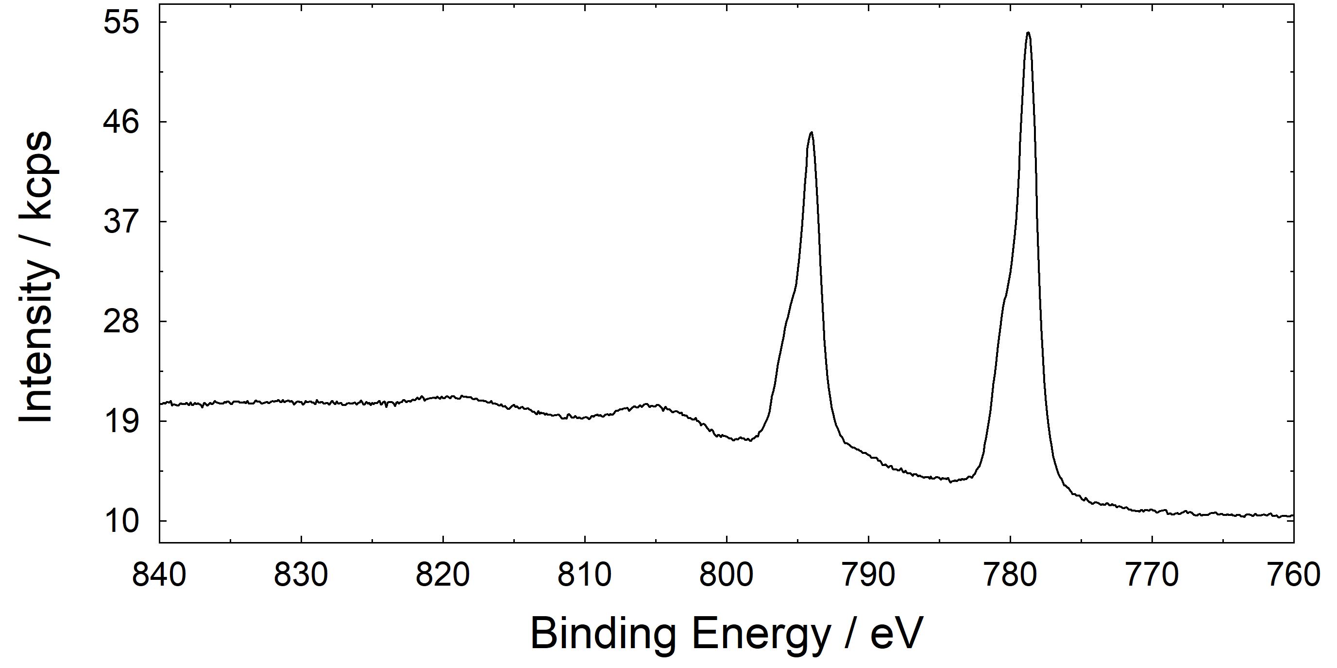
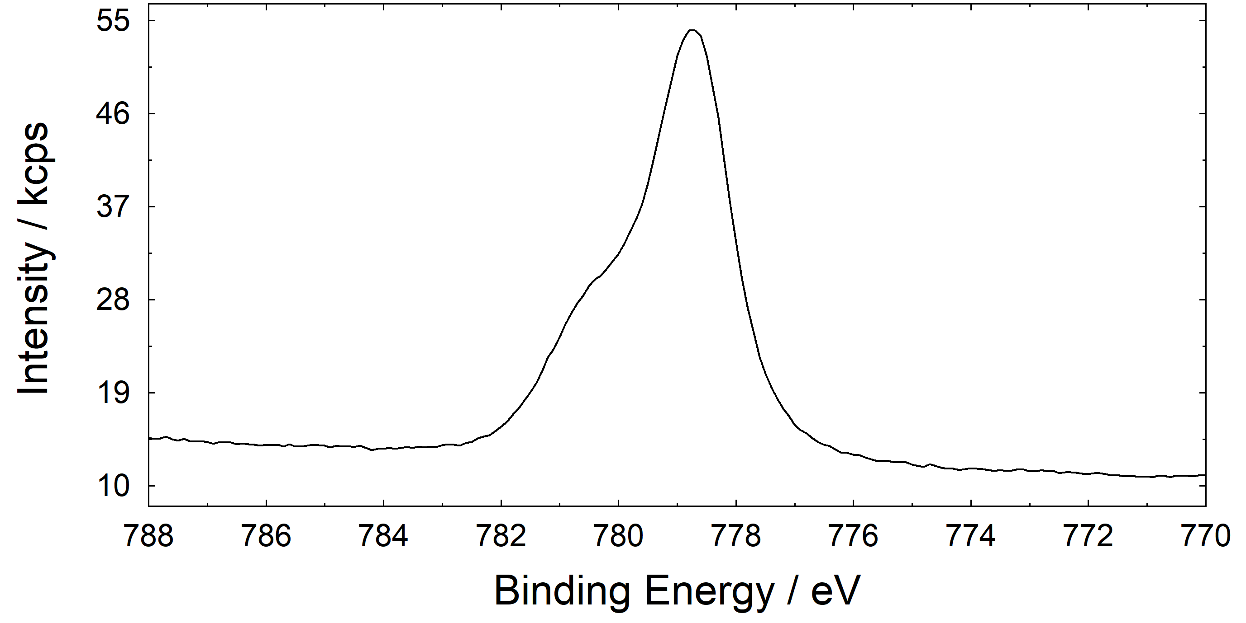
6. modification – Reduction/expansion
example: Ba 3d from thin BTO layer on STO
Please note
The marker lines can be defined or removed using Pop-Up operations. Displayed marker lines can be shifted with the mouse.
wide range
spectra
Reduction
short range spectra
Expansion
Please note
The popup menu of standard windows with and without plotted reduction lines is different!
path: Modify → Reduction/Expansion or

Slide 35
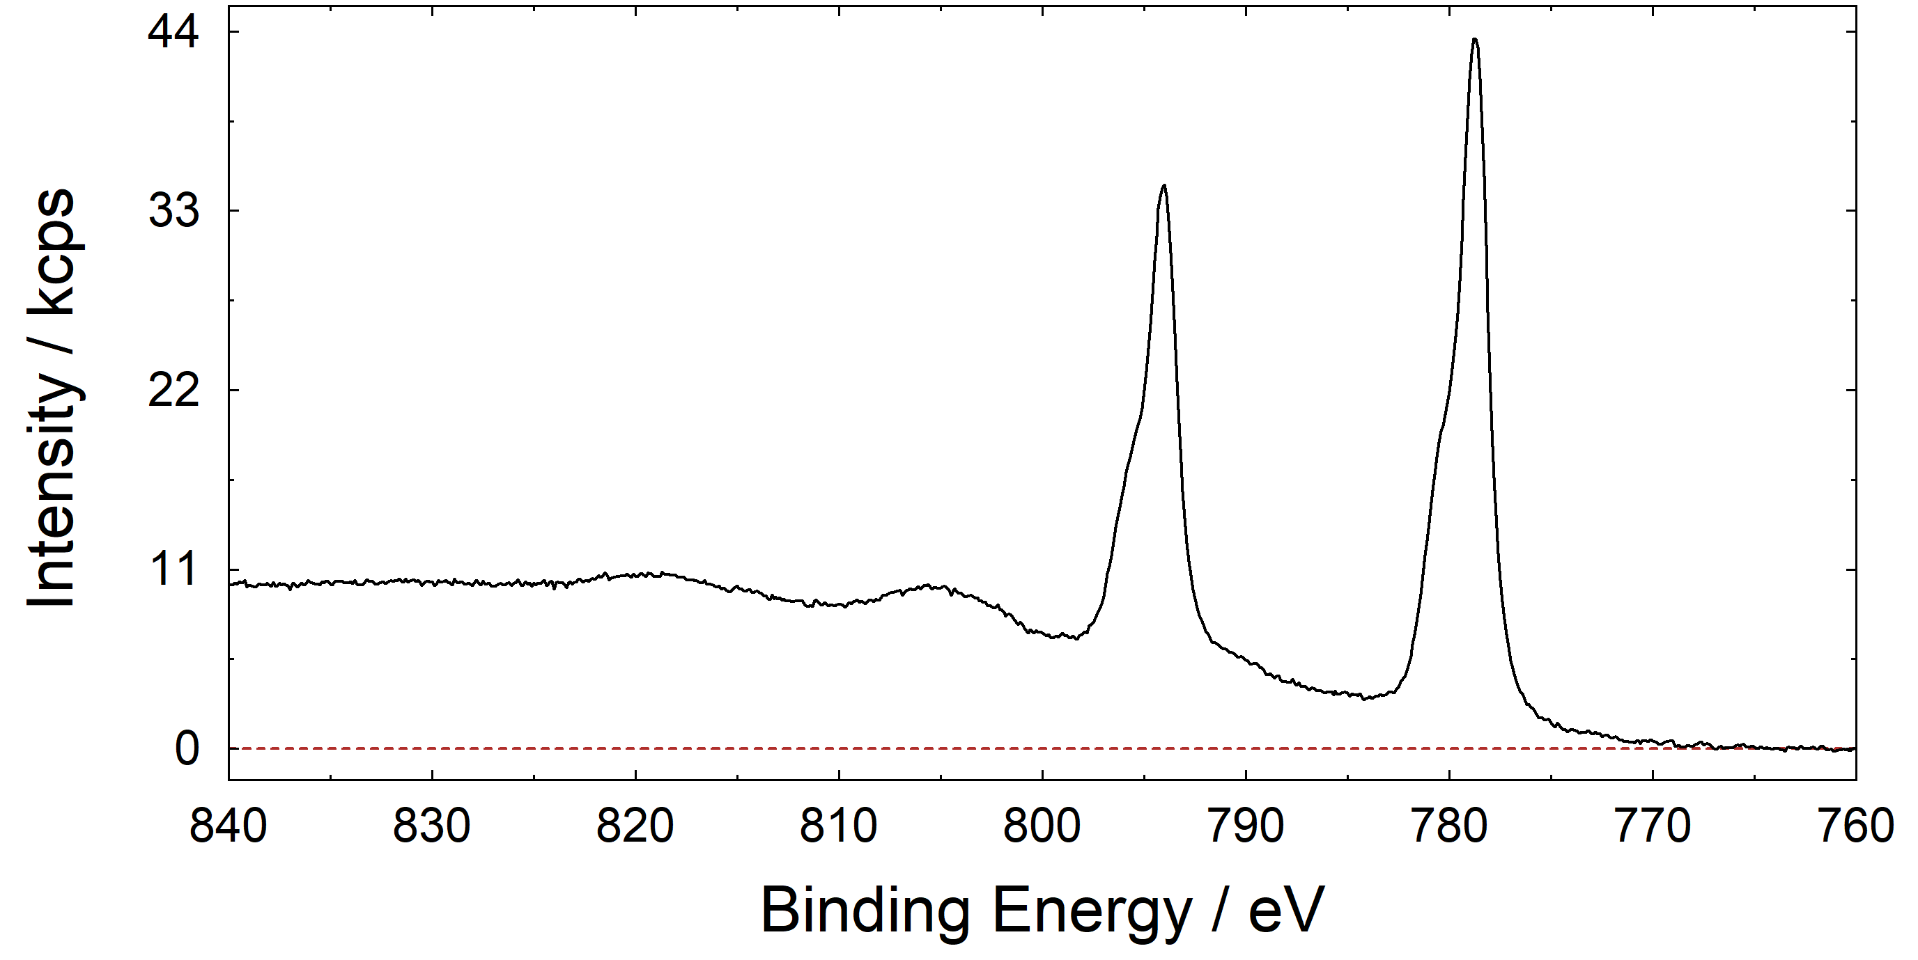
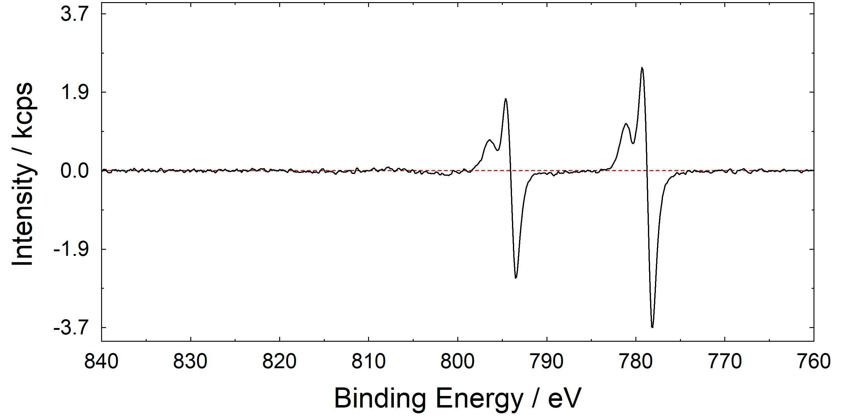
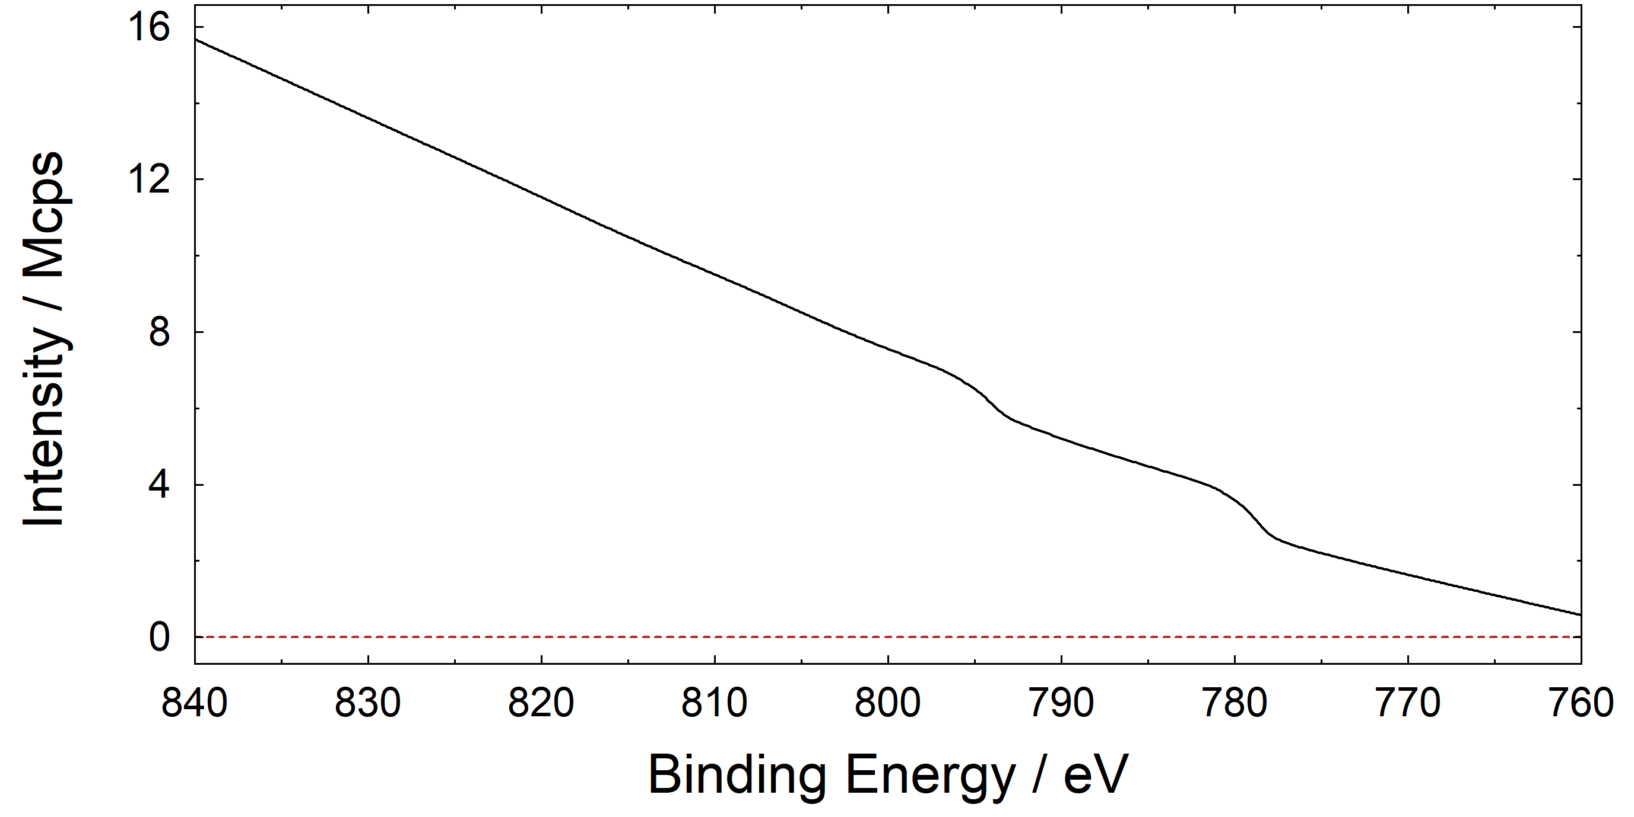
6. modification – Differentiation/Integration
example: Ba 3d from thin BTO layer on STO
Please note
Result depends from the number of Average Points!
original
Differentiation
Integration
path: Modify → Differentiation/Integration

Slide 36
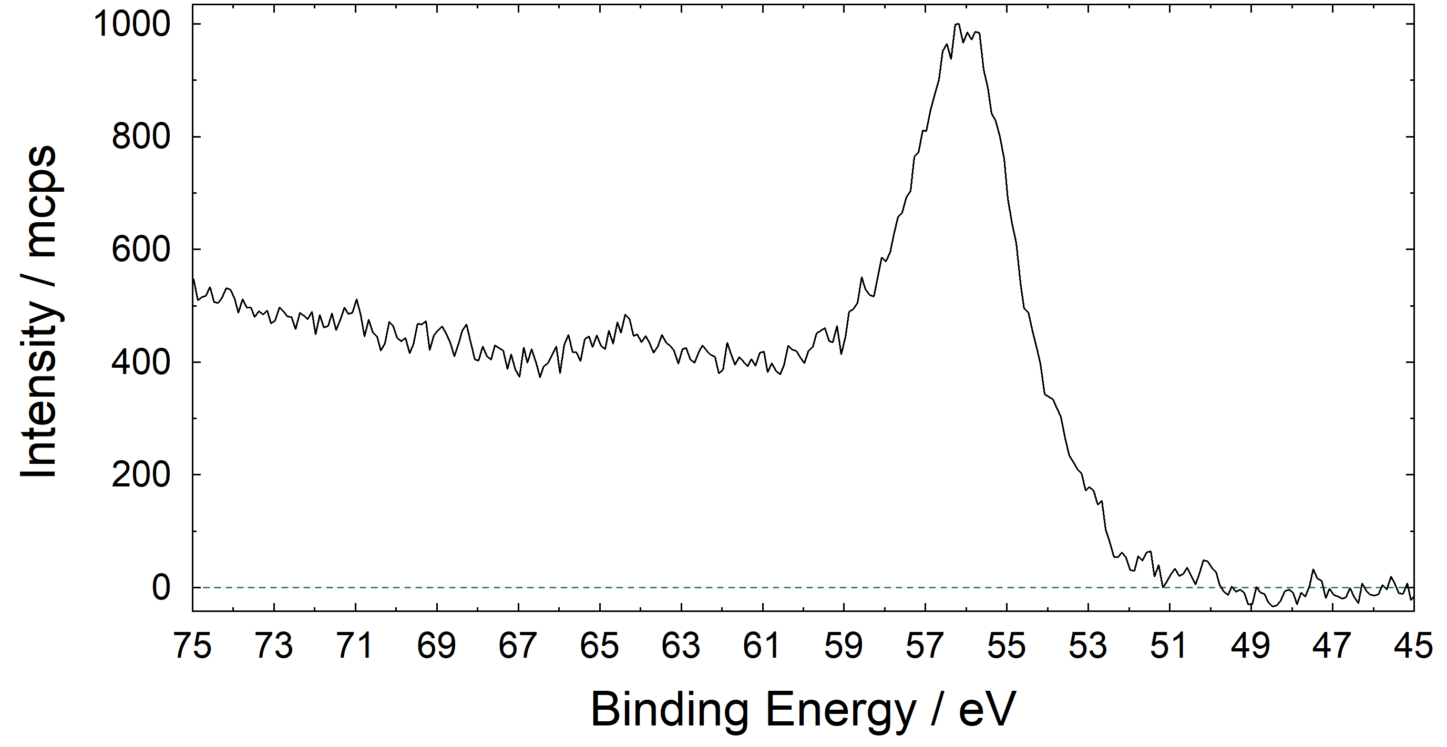
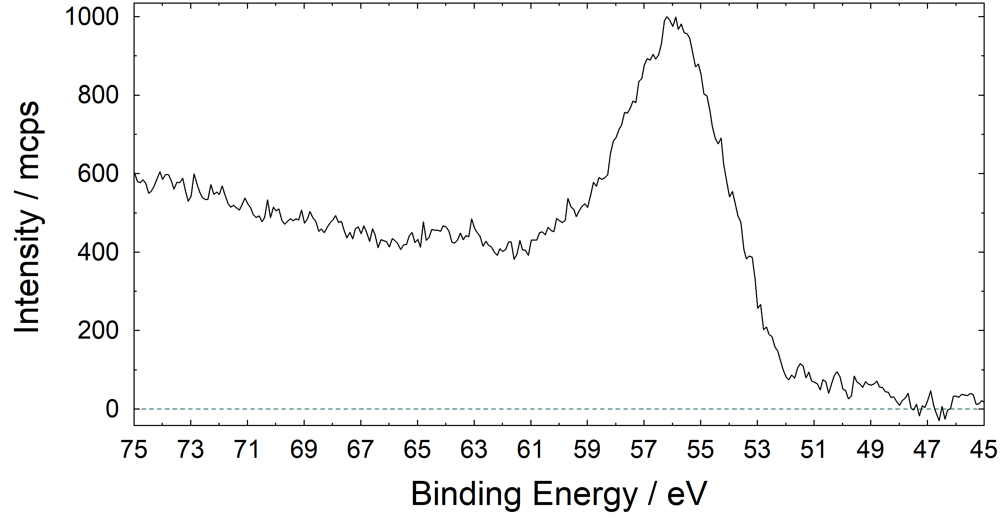
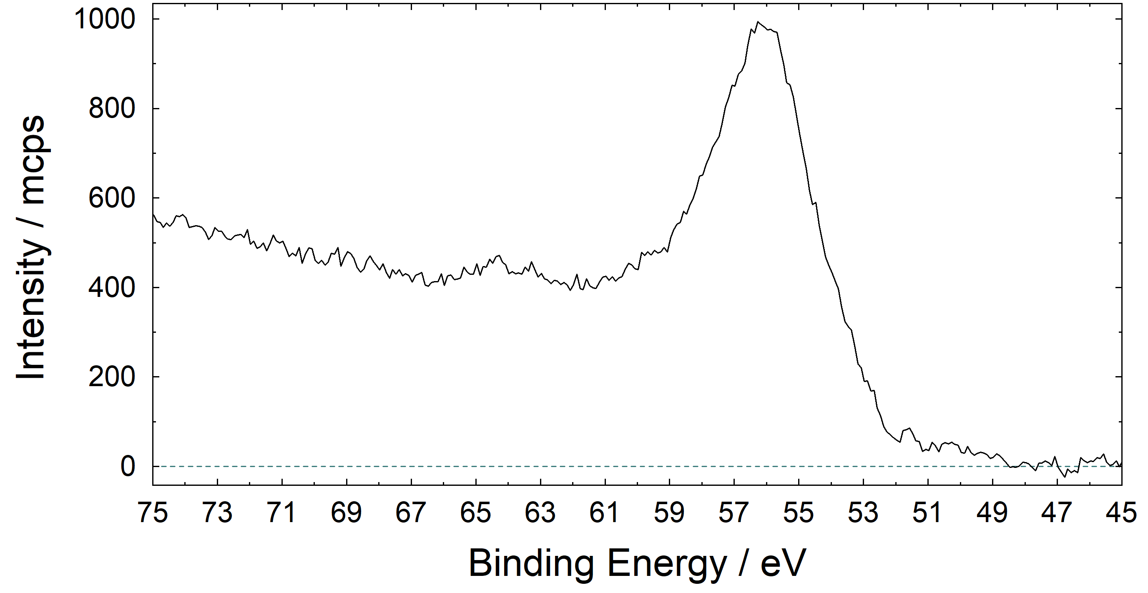
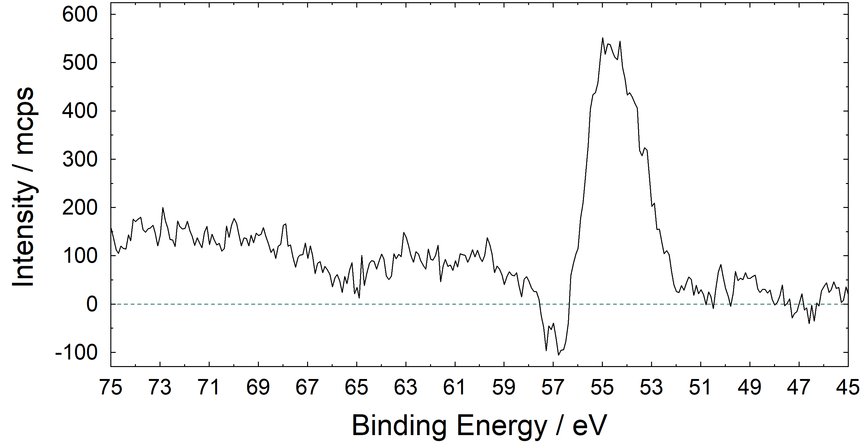
6. modification – Addition/Subtraction
example: Fe 3p from thin ZnFe₂O₄ and Fe₃O₄ layer
(Multiplcation and division also possible)
Spectrum 1
ZnFe₂O₄
Spectrum 2
Fe₃O₄
Addition
(and division by 2)
Subtraction
path: Modify → Spectrum Operation → Addition/Subtraction

Slide 37
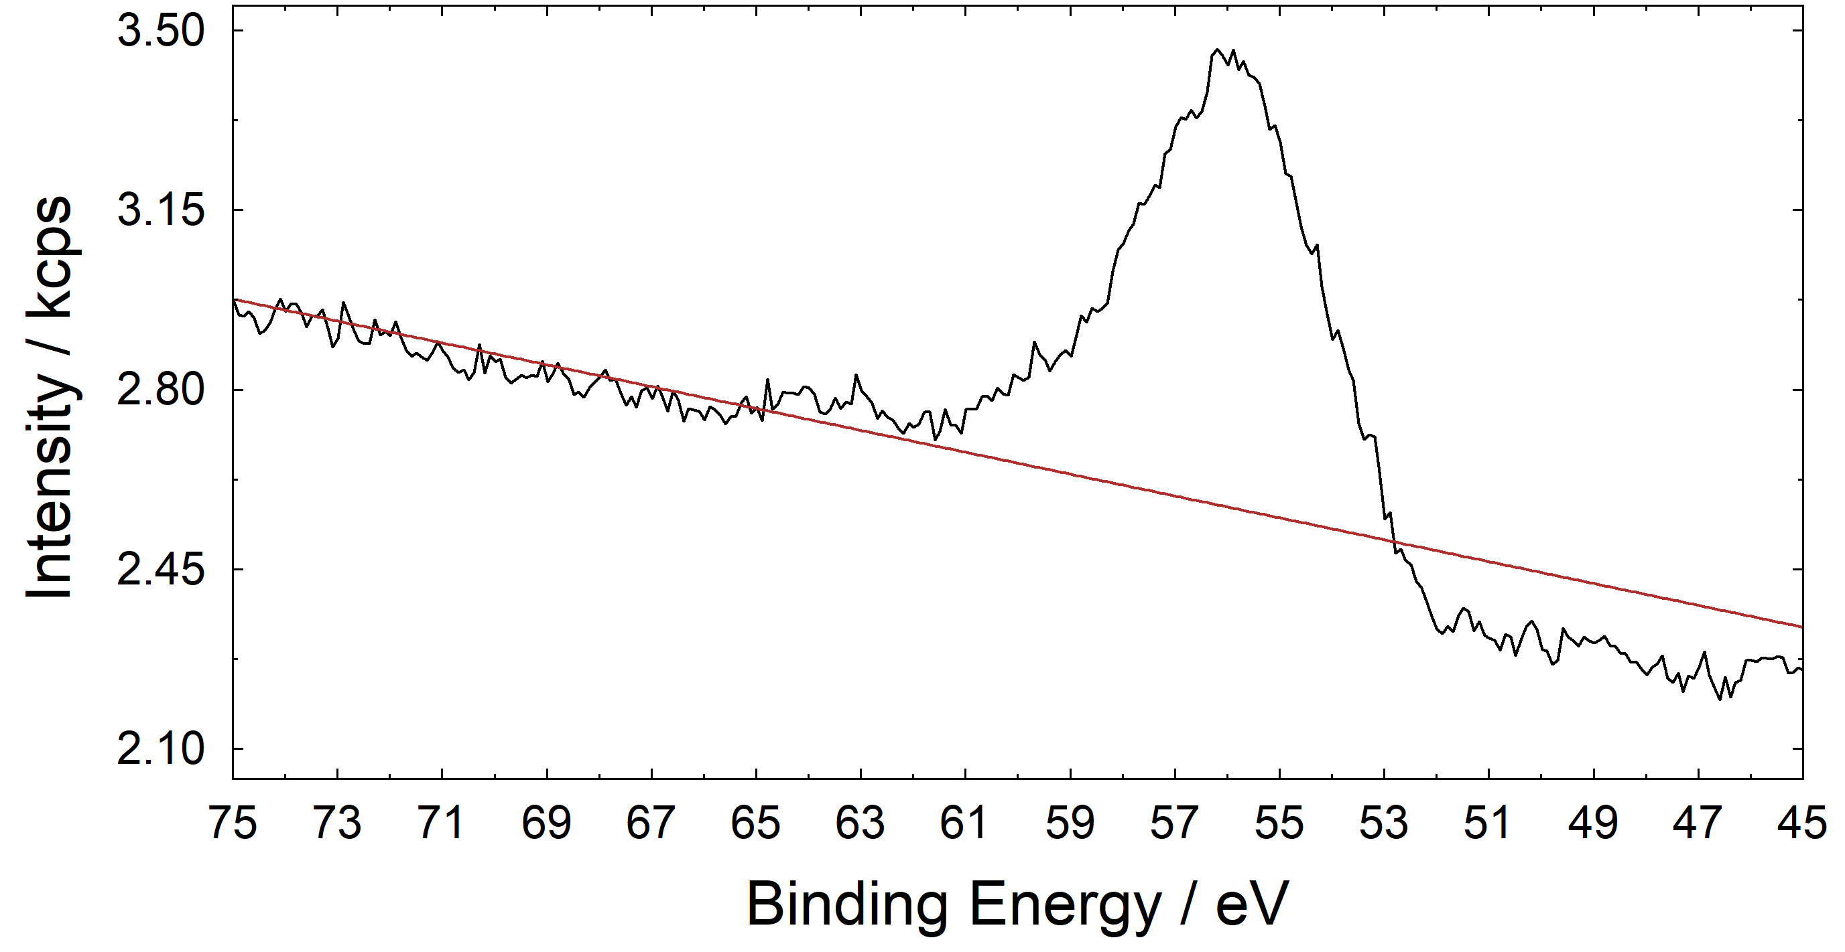
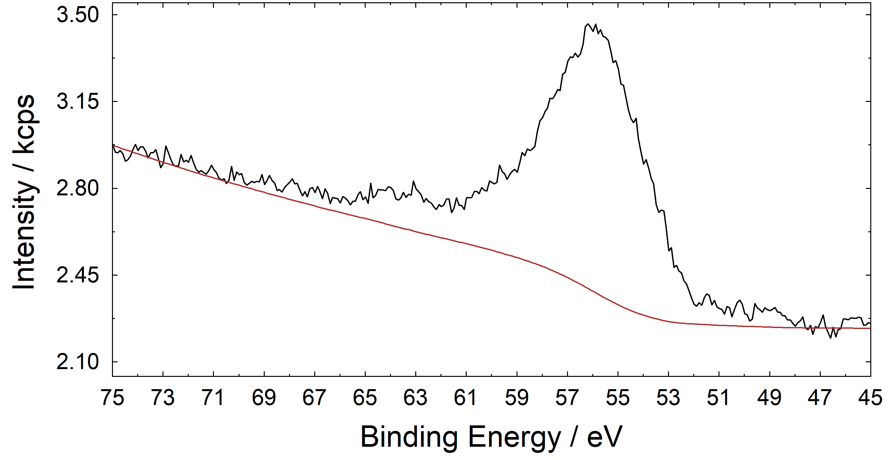
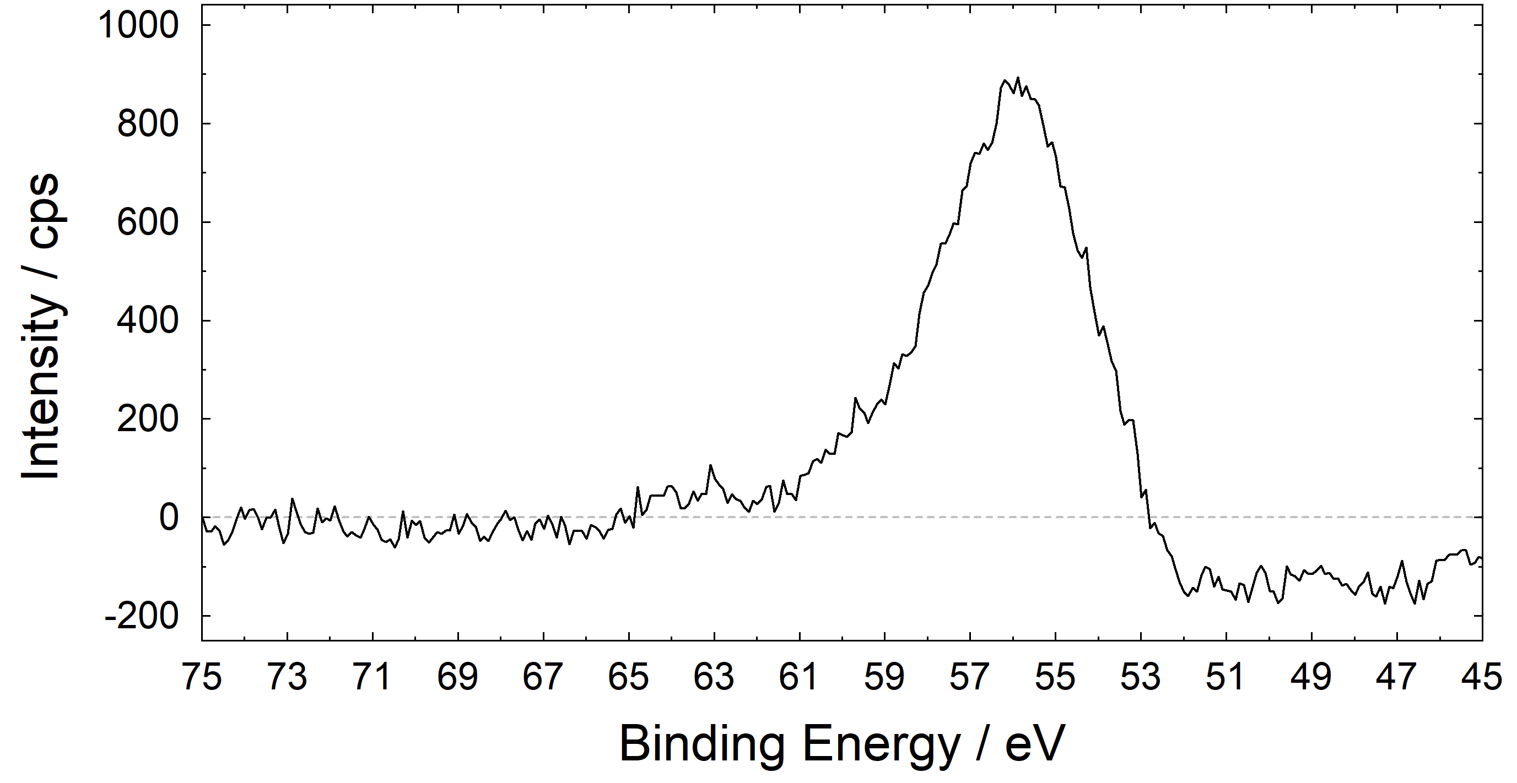
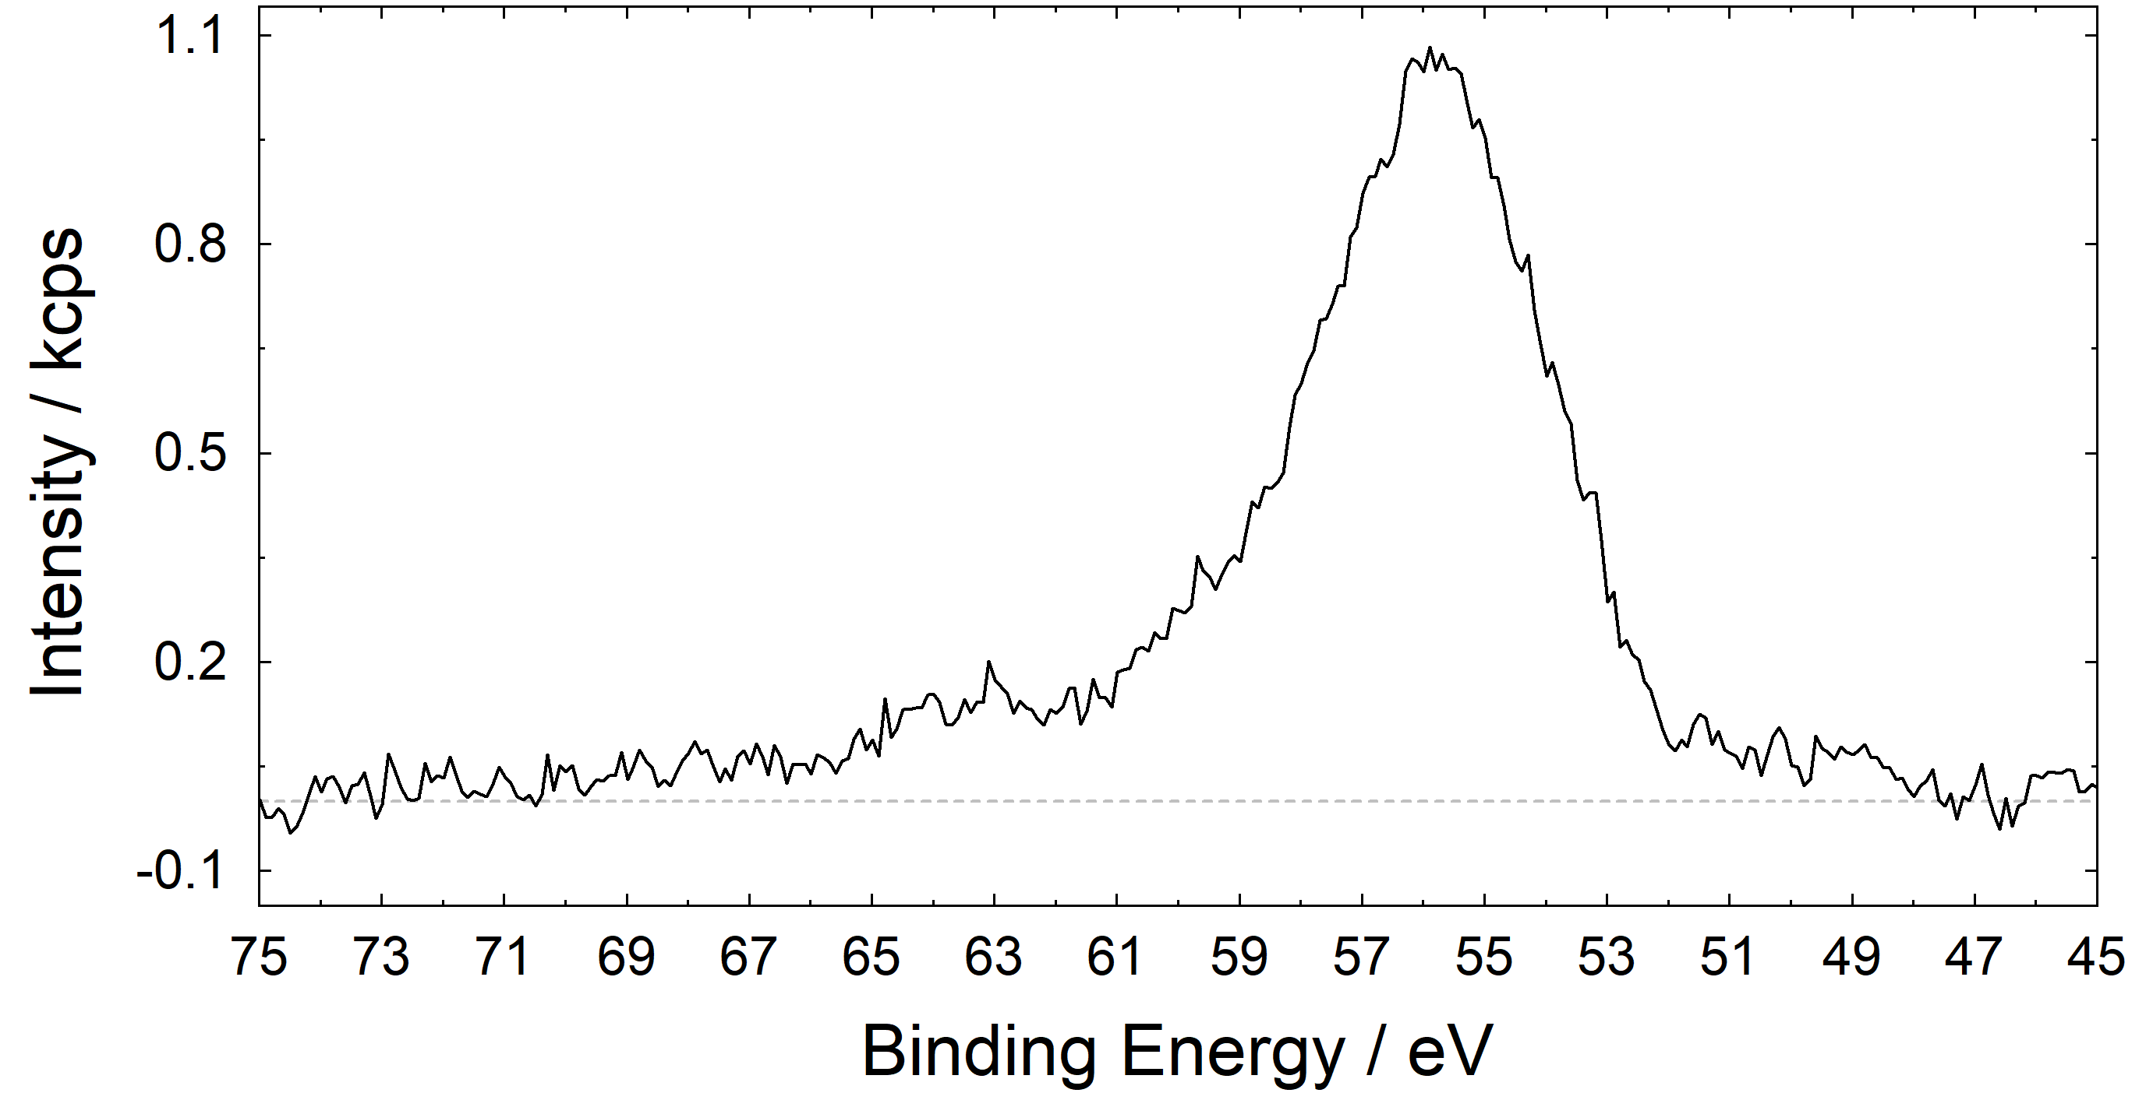
6. modification – Background subtraction
example: Fe 3p from thin Fe₃O₄ layer
before subtracting a linear background
before subtracting a Shirley background
after subtracting a linear background
after subtracting a Shirley background
path: Modify → Calculate Background or Subtract Background

Slide 38
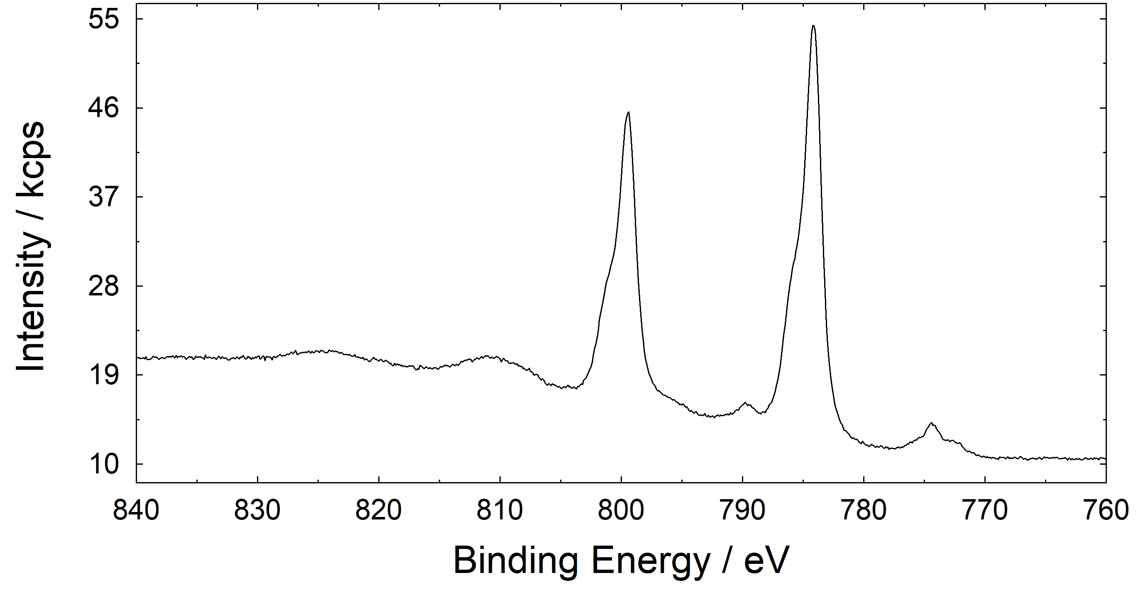
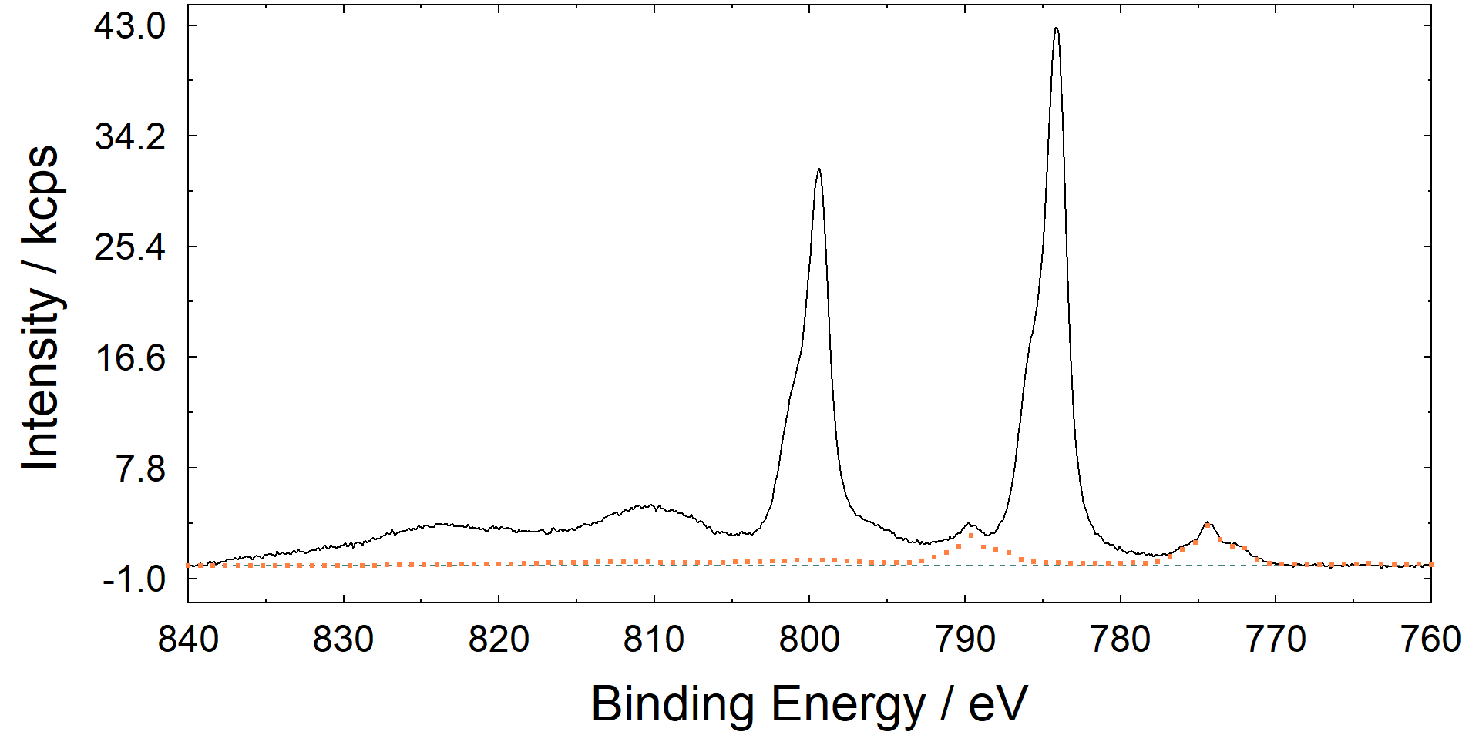
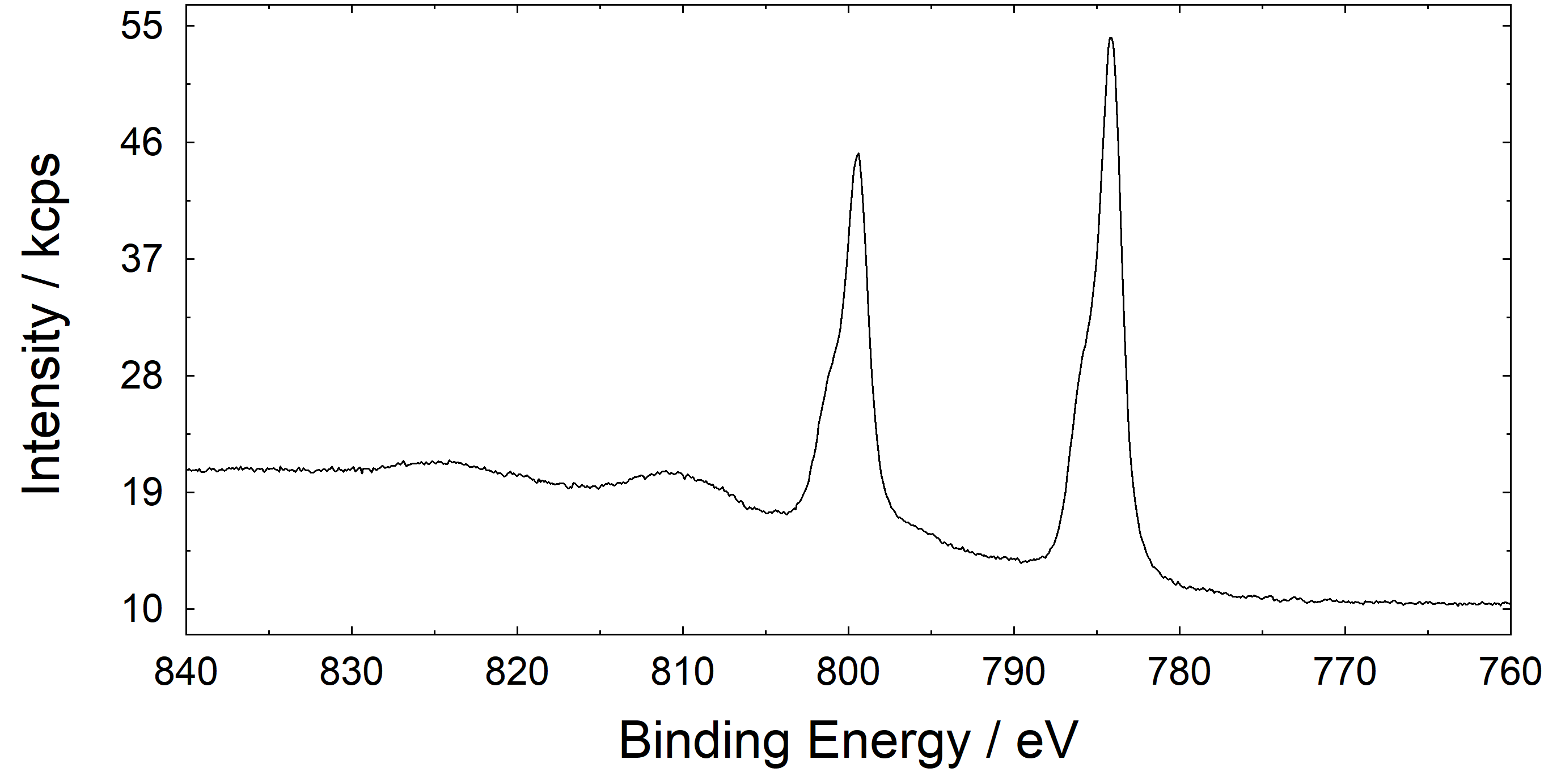
6. modification – Subtract Satellite
New from UNIFIT 2024
example: Ba 3d from thin BTO layer on STO
before satellite subtraction
satellites to be subtracted
Al Kα_{3,4} satellites
after satellite subtraction
path: Modify → Subtract Satellite and Preferences → Satellite Selection

Slide 39
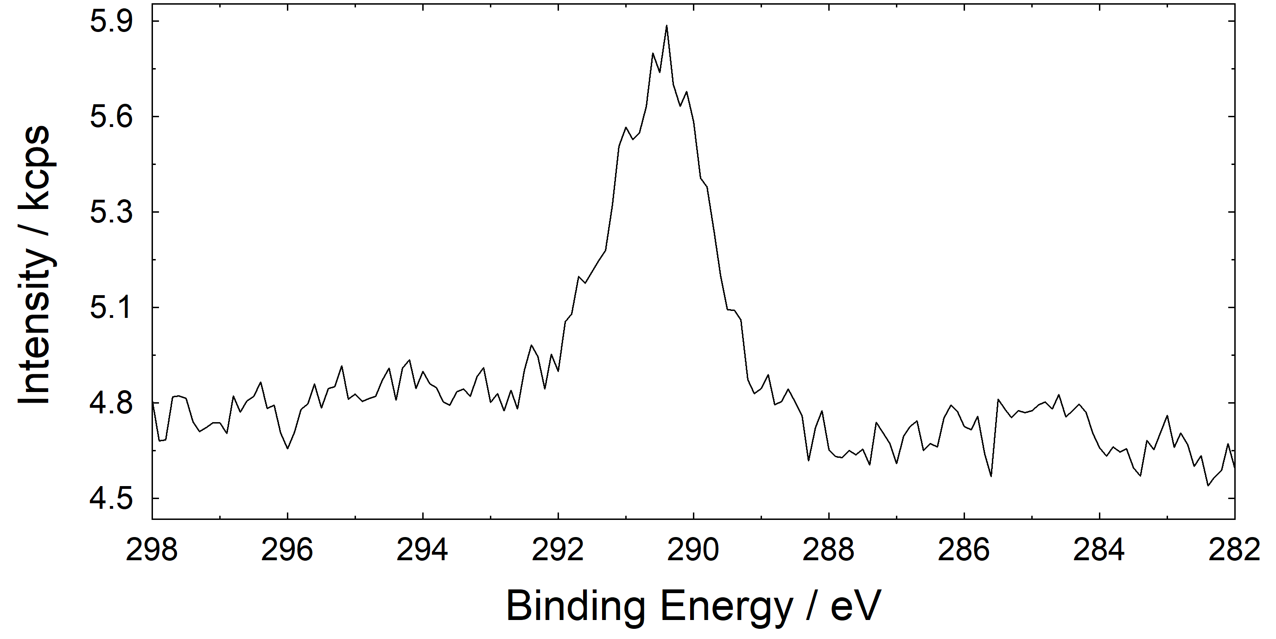
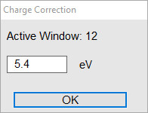
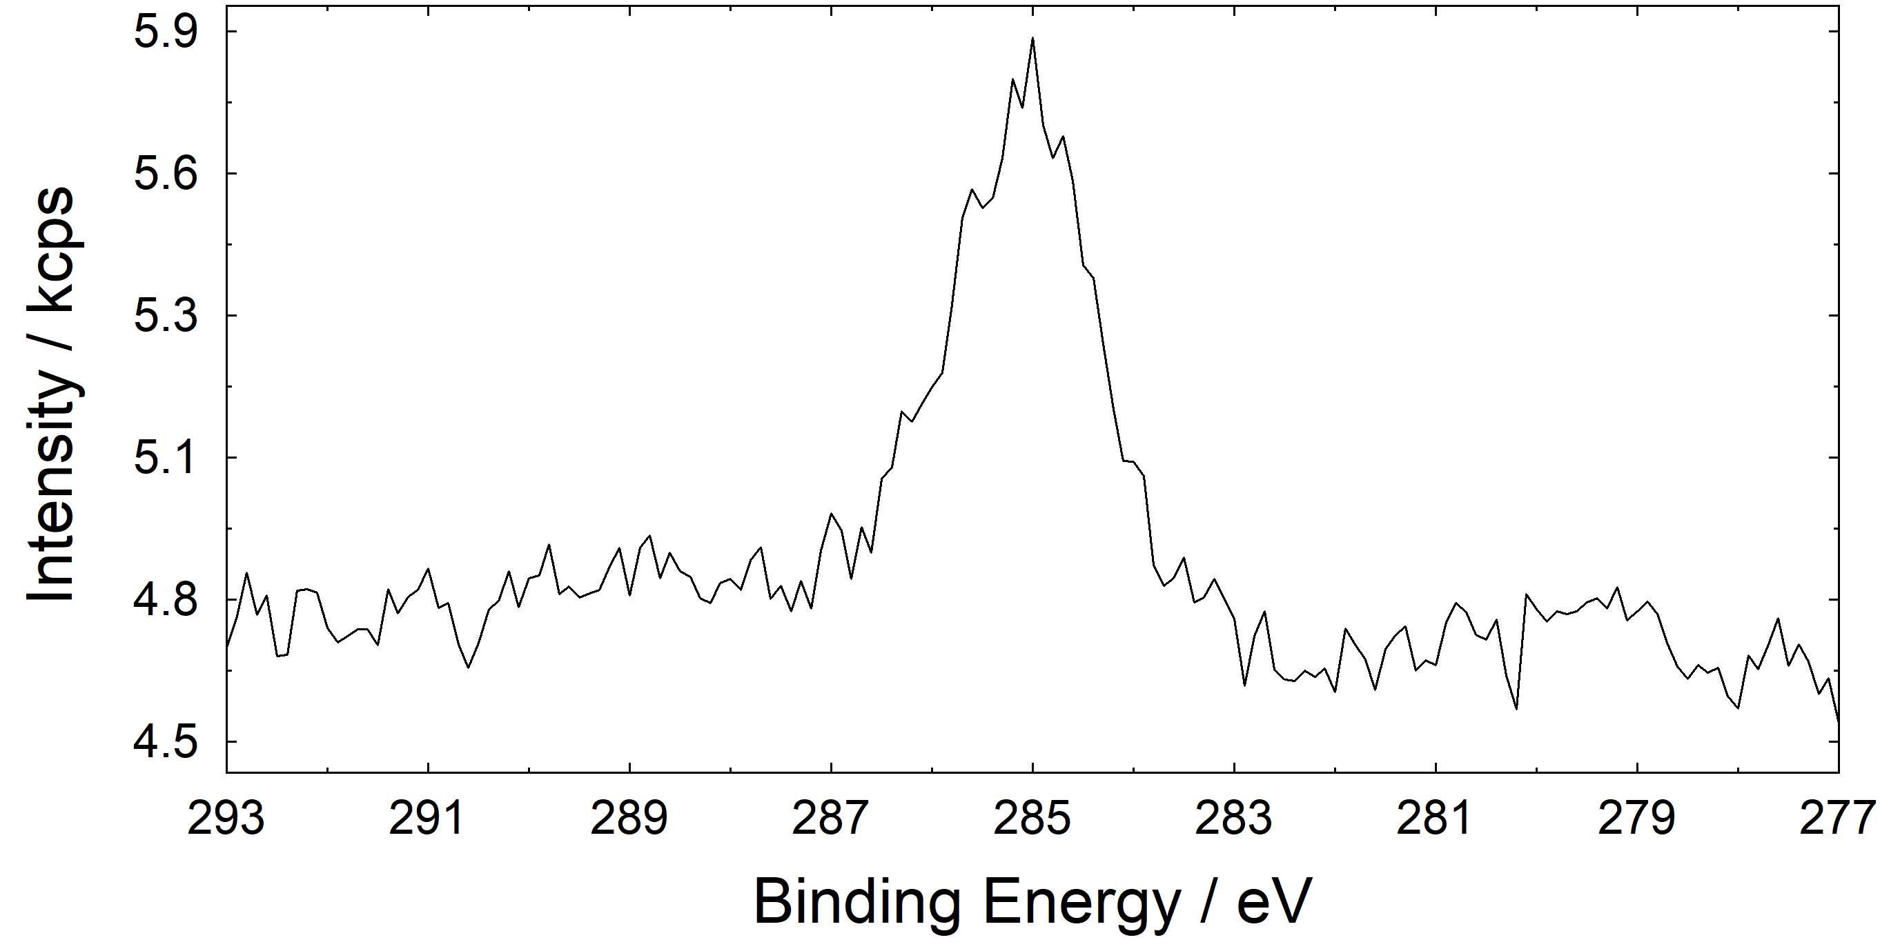
6. modification – Charge Correction
example: C 1s from thin BTO layer on STO
C 1s at BE 290.4 eV
C 1s at BE 285.0 eV
positive charging → positive value
negative charging → negative value
path: Modify → Charge Correction Active Window

Slide 40
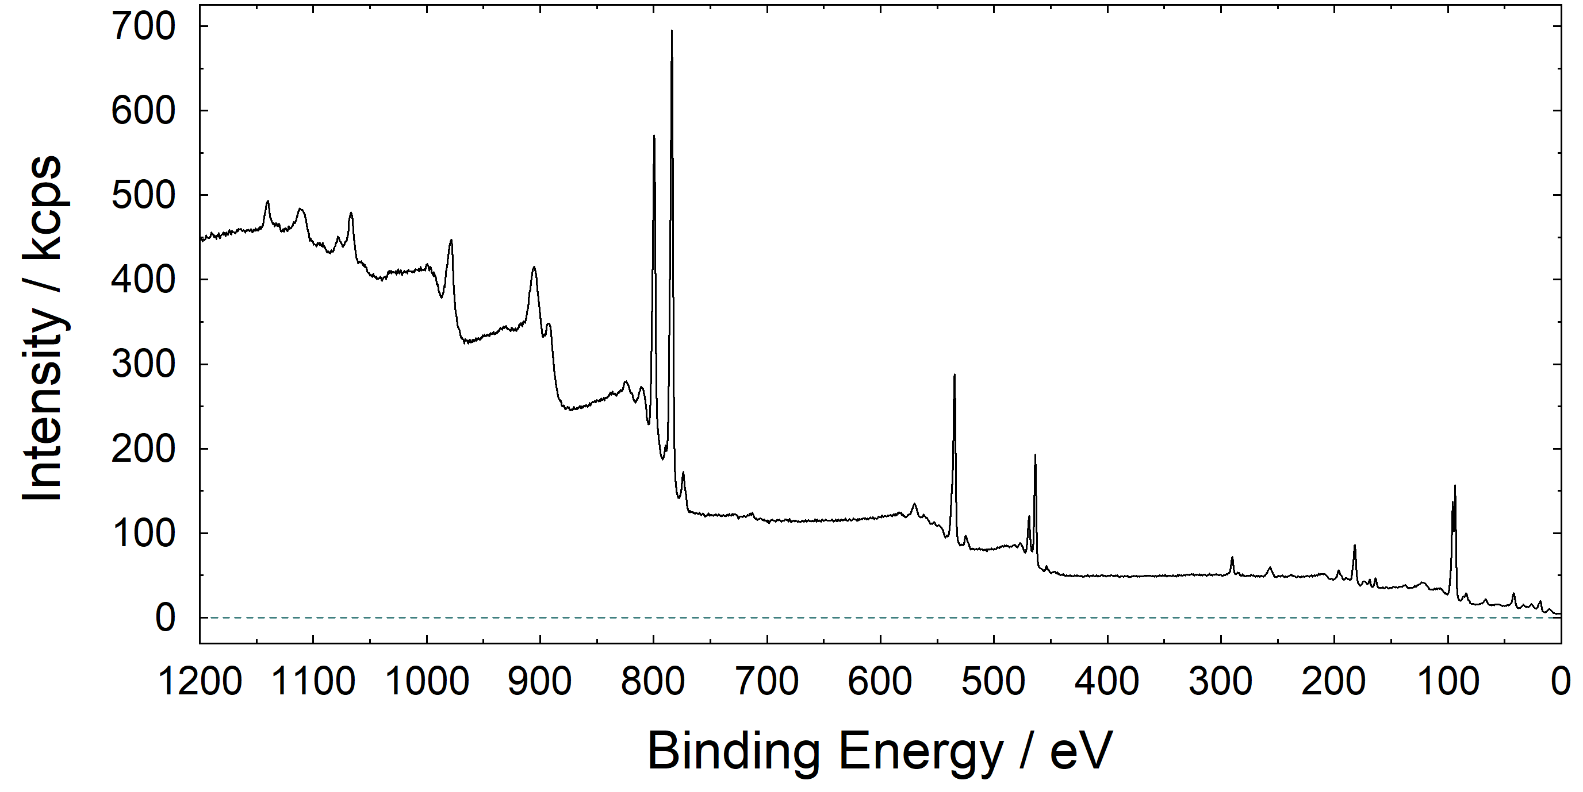
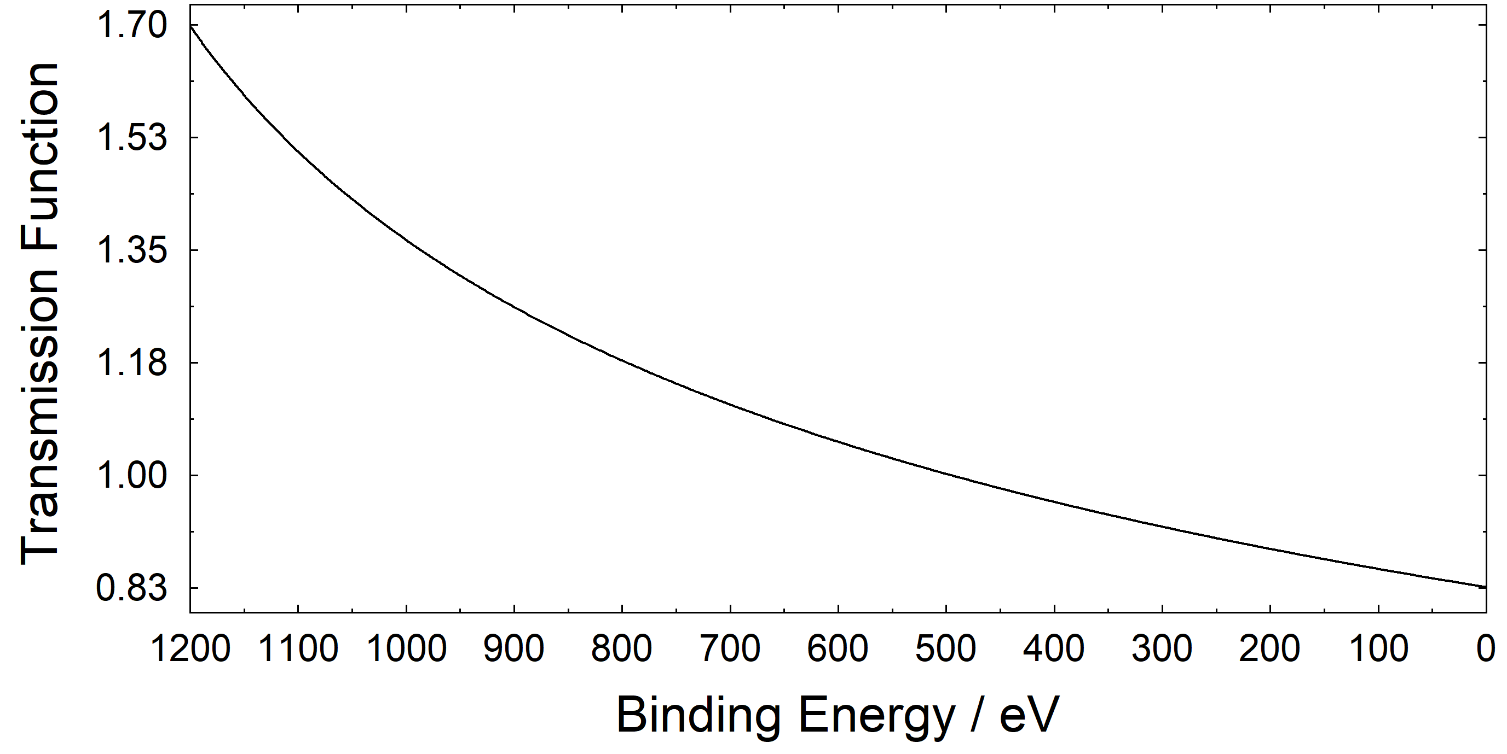
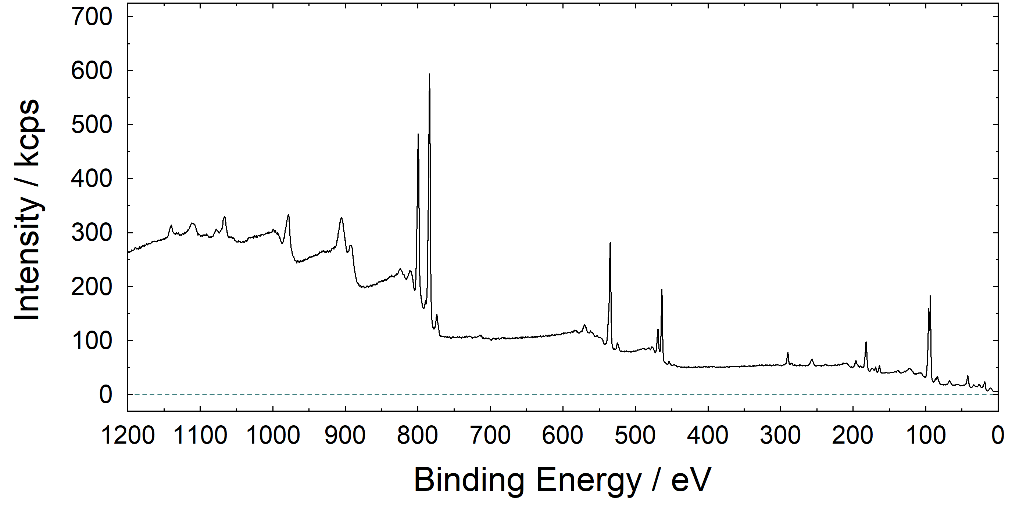
6. modification – Correction with transmission function
example: survey from thin BTO layer on STO
before correction with IERF
after correction with IERF
path: Modify → Correction with IERF
path to load/define IERF: Preferences → Load/Define Transmission Function

Slide 41
7. Fitting
UNIFIT 2024 offers a huge variety of fit routines
Method of optimization: Marquardt-Levenberg
XPS/XAS/AES/RAMAN Peaks:
Peak Type (singlet/doublet)
Fit Parameters (relative/absolute)
Fit Procedure (product/sum/convolution)
Background Function (polynominal/SHIRLEY/TOUGAARD)
Combination of Peak Fit and Background Fit
(parallel/consecutively)
TOUGAARD Background Calculation (homogeneous/inhomogeneous samples)
Specials:
Valance-Band Edge (two model functions: linear or square root))
Fermi-Edge (Theta-model function)
Transmission function

Slide 42
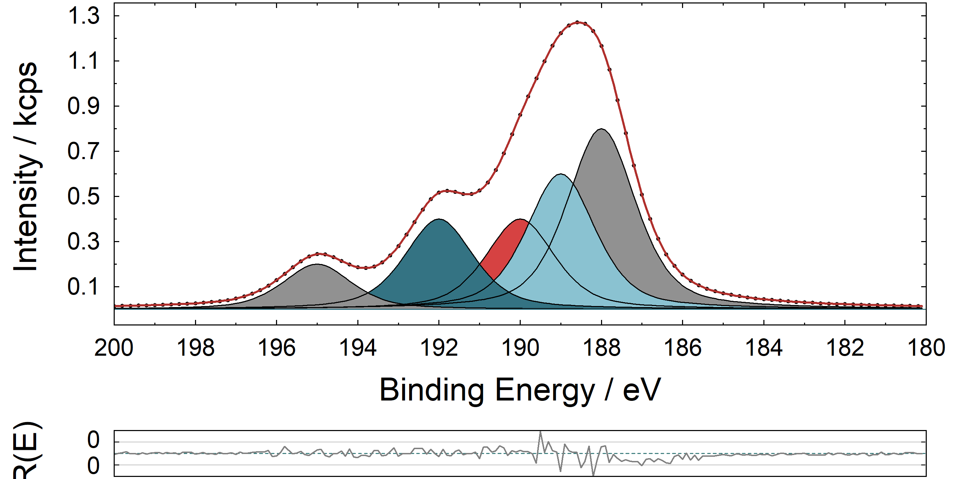
7. Fitting – Master & slave Peaks
color code
Master peak, activated for input
Master peak, not activated
Slave Peak, activated for input
Slave Peak, not activated
1
4
3
2
5
Parameter setting: Relative
Parameters of slave peaks with higher component number can be linked to the parameters of the corresponding master peak.

Slide 43
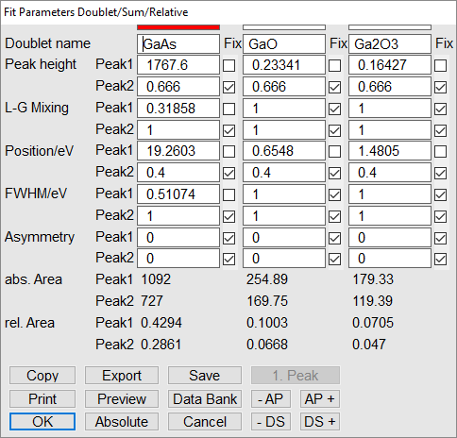
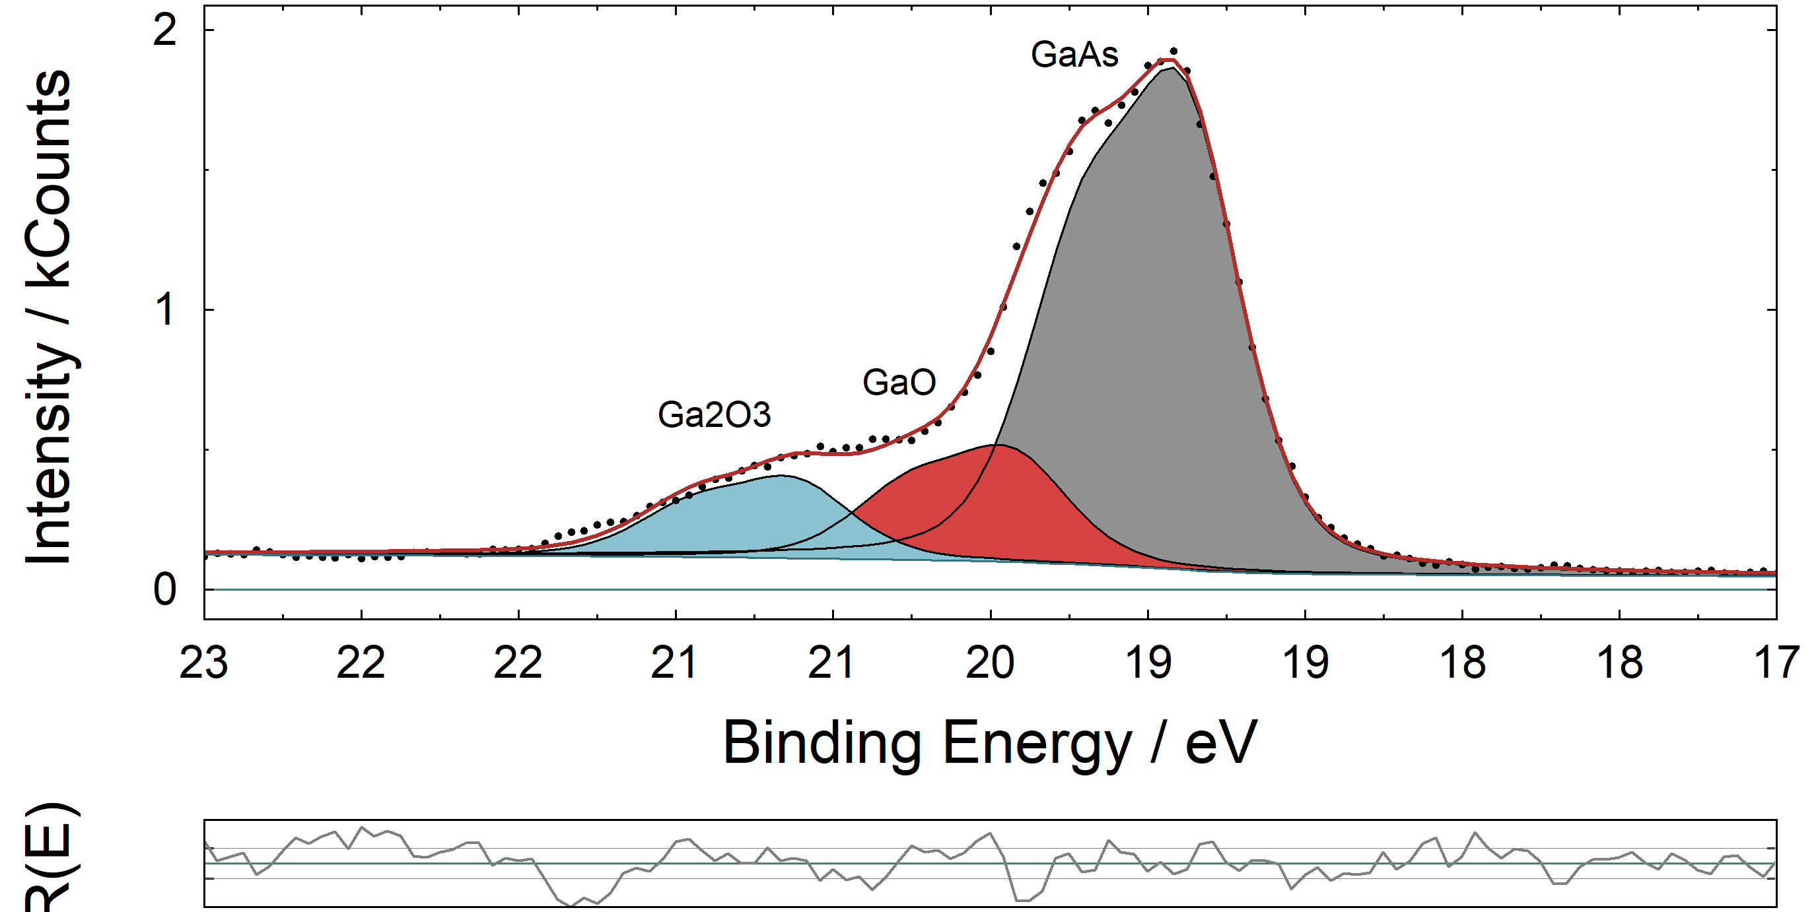
7. Fitting – Peak Type
example: Ga 3d from GaAs
three doublet peaks
six singlet peaks
path: Peak Fit → Manual Input of Start Parameters

Slide 44
7. Fitting – Fit Parameter
example: As 2p_{3/2} from GaAs
relative
absolute
path: Preferences → Fit Parameters

Slide 45
7. Fitting – Fit Procedure
example: O 1s from thin BTO layer on STO
 |  |  | Abbe
Product | 2.46 | 371.8 | 0.28
Sum | 1.07 | 161.5 | 0.55
Convolution | 0.93 | 141.1 | 0.63
path: Preferences → Fit Procedure

Slide 46
7. Fitting – Background function
example: Fe 3p from thin Fe₃O₄ layer on MgO
constant
linear
Shirley
Tougaard
path: Modify → Calculate Background

Slide 47
7. Fitting – Inhomogeneous Samples
example: test spectra
Shirley background
Tougaard background for homogeneous samples
Tougaard background for INhomogeneous samples
path: Preferences → Tougaard Background Calculation

Slide 48
7. Fitting – Batch Processing
example: test spectra
path: Batch Processing → Batch Processing

Slide 49
8. Evaluation
Qualitative Analysis
Quantitative Analysis (with fit-parameter errors)
Chemical Analysis
Parameter Plots
3D Plots
XY 3D Plots
Layer Thickness Estimation

Slide 50
8. Evaluation – Qualitative Analysis
example: survey from GaAs with oxidized surface layer
All Lines/Important Lines/Element Lines
manual or automatic annotation
Delta E/eV and Delta I(E)/cps
Check with Mainlines
path: Information → Identify Lines

Slide 51
8. Evaluation – quantitative Analysis
example: Ga 3d and As 3d spectra of GaAs with oxidized surface layer
Ga 3d
choose the lines of interest
As 3d
path: Quantification → Concentration

Slide 52
8. Evaluation – quantitative Analysis
Ga 3d
Quantification Table
choose compound which should be included in the quantification
load the correct sensitivity factors
load the correct transmission function
parameter plot
As 3d
path: Quantification → Concentration

Slide 53
8. Evaluation – quantitative Analysis – 100 %
100 %

Slide 54
8. Evaluation – Fit Parameter Errors
example: Ti 2p from thin BTO layer on STO
Calculation of Errors
Iterative
Matrix Inversion
path: Peak Fit → Show Fit-Parameter Errors

Slide 55
8. Evaluation – Layer Thickness Estimation
example: example: As 2p_{3/2} and As 3d spectra of GaAs with oxidized surface layer
As 2p_{3/2}
Energy resolved XPS (ERXPS)
Energy resolved XPS (ERXPS)
As 3d
path: Quantification → Thickness Estimation 1 (ERXPS)

Slide 56
8. Evaluation – Layer Thickness Estimation
example: Cu 2p
Angular resolved XPS (ARXPS)
0°
15°
30°
45°
60°
path: Quantification → Thickness Estimation 2 (ARXPS)

Slide 57
8. Evaluation – Chemical Analysis
example: As 2p_{3/2} spectra of GaAs with oxidized surface layer
path: Information → Identify Lines → Chemical Shift

Slide 58
8. Evaluation – Saving of Processing steps
New from UNIFIT 2019
Saving of the compete evaluation using UNIFIT project (*.ufp) or
export of processing steps and design features of selected regions in one *.ppd file
→ easy re-use for other data sets
selection of regions on which steps/designs shall be applied on
regions must have the same name as original one (optionally without batch parameter)
formatted titles and labels, interpolations operations and charge corrections are not saved
path: File → Save/Open Project Processing Steps/Design Standard Windows

Slide 59
8. Evaluation – 3d Plots
example: test spectra
Waterfall (-45°)
Color Profile (Spectrum)
Waterfall 0° Plus (fitted Spectra)
Color Profile (Component 1)
path: Batch Processing → Plot 3D …

Slide 60
8. Evaluation – Video Sequence
example: test spectra
Please note
All video-sequence windows can be exported automatically. An animated gif file can be generated using the software gifanimator.exe! (included in the software package)
path: Batch Processing → XY Plot 3D …

Slide 61
8. Evaluation – XY 3d Plots
example: test spectra
XY 3D Color Plot (Component 2)
XY 3D Plot 45° (Component 2)
XY 3D 45° Color
(Component 2)
path: Batch Processing → Plot 3D …

Slide 62
8. Evaluation – XY 3d Plots – Improvement of Resolution
New from UNIFIT 2019
example: GaAs sputter depth profile, As 2p_{3/2}
x4
x16
seperately for x and y axis
Note: it is only an virtuell improvement of your data!
path: Annotation/Design→ Plot X-axis/Plot Y-axis or click with right mouse button on relevant axis

Slide 63
8. Evaluation – Parameter Plots
example: test spectra
path: Batch Processing → Plot Fit Parameters

Slide 64
8. Evaluation – Parameter Plots
example: test spectra
by adept choosing of windows, e.g. a diagonal cut through an area is possible
path: Batch Processing → Plot Fit Parameters

Slide 65
9. Presentation - Design – Insert
grid lines/marker lines/residual lines
annotations/spectrum title/spectrum labelling
legends
graphics
(graphics have to be opened in e.g. word file, copied to cache and inserted via ‚Annotation/Design → Spectrum Title 2‘)
path: Annotation/Design …

Slide 66
9. Presentation - Design – Title/LABELLING
annotations/spectrum title/spectrum labelling: 1. ‚OK Plus New Labelling’ 2. Automatic position, ‘Selected Window’ 3. ‘Plus Batch Parameter’, ‘Plus Numbering’ 4. Manual definition of the position x and y
New from UNIFIT 2022
path: Annotation/Design …

Slide 67
9. Presentation - Design – Change
colours (graphs, axis, fill colours of the components, fill colour background, …)
sizes & fonts (tick numbers, annotations, labelling, ….)
styles (solid line, dots, squares, circles, …)
axis (scaling, increments, …)
sequence of components
path: Preferences → Display → … or click with right mouse button on relevant axis/area

Slide 68
9. Presentation - Design – Change
New from UNIFIT 2019
manual definition of number of points shown in spectra
all
every 2nd
every 4th
path: Preferences → Display → … or click with right mouse button on relevant axis/area

Slide 69
10. Information
path: Information → …

Slide 70
11. Export – Data (*.dat files)
Spectrum/Modified Spectrum
Background/Satellite Background
Sum Curve/Components
Residual
Peak Height/Peak Position
L-G-Mixing/FWHM
Asymmetry
Fit Background
Fit Parameter Errors
various delimitations and decimal characters
Export Data Active Window…
Export Data All Standard Windows…
Export Data Standard Windows…
path: File → Export Data…

Slide 71
11. Export – image (various formats)
Standard Windows
Parameter Plots
3D Plots
XY 3D Plots
Quantification Table
Fit Parameters
Fit Background
The active window, selected windows or all windows can be
exported
copied (Copy/Paste function) or
printed-out (optional with fit results and acquisition parameters).
various resolutions and image file formats
path: File → Export Image or Copy Image or Print…

Slide 72
12. X-ray Absorption Spectroscopy

Slide 73
12. Auger Electron Spectroscopy
Differentiation
Ti (L3M23M45)
C (KVV)

Slide 74
12. RAMAN Spectroscopy

Slide 75
12. RAMAN Spectroscopy – automatic Spike correction
New from UNIFIT 2019
based on modified Laplace method
manual definition of threshold for spike identification
spike identification with neighbouring channels and spectra
before
after
path: Batch Processing → Spike Correction All Windows

Slide 76
Complete Example of XPS Data Fit

Slide 77
example: Ba 3d_{5/2} from thin BTO layer on STO
① charge correction
recorded data:
Ba 3d signal from 760 to 850 eV
path: Modify → Charge Correction Active Window
charge corrected data

Slide 78
example: Ba 3d_{5/2} from thin BTO layer on STO
② satellite subtraction
path: Modify → Satellite Subtraction
data without excitation satellites

Slide 79
example: Ba 3d_{5/2} from thin BTO layer on STO
③ reduction of spectral range
set left border with left mouse button and right border with right mouse button
path: Modify → Reduction or
reduced range of data

Slide 80
example: Ba 3d_{5/2} from thin BTO layer on STO
④ inserting a fittable background
path: Peak Fit → Fit Background XPS

Slide 81
example: Ba 3d_{5/2} from thin BTO layer on STO
⑤ inserting fittable peaks
path: Peak Fit → Manual Input of Start Parameters → Singlet Peaks
several parameter windows will open
How many peaks?
Minimum and maximum values
of peak parameters?

Slide 82
example: Ba 3d_{5/2} from thin BTO layer on STO
⑤ inserting fittable peaks
1. inserting the peaks by clicking at an approximate position
2. fixing of peak parameters
Peak Parameters?

Slide 83
example: Ba 3d_{5/2} from thin BTO layer on STO
⑥ running a peak fit

Slide 84
example: Ba 3d_{5/2} from thin BTO layer on STO
⑦ customize the layout
open the layout dialogues by clicking into the ares of interest

